Slide 1

MAJOR PROJECT PRESENTATION ON STOCKPILE : AN INVENTORY MANAGEMENT SYSTEM
SUBMITTED BY
NITUMONI NEOG (ROLL NO.: 34)
PRIYA SUBHALKHMI HARARIKA(ROLL NO.: 41)
SUSMITA SHARMA(ROLL NO.: 53)

Slide 2
CONTENTS
Introduction
Objective
Key Features
Requirement Analysis
System Design
Security Measures
Snapshots
Conclusion

Slide 3
INTRODUCTION
“STOCKPILE” (Inventory Management System) software is a web-based application that offers a system to organize and manage stock registers, stock levels & also stock related files of Assam Agricultural University.
This system is implemented to replace the manual system i.e. the traditional register based inventory recording system.
There would be four-different-level users to the system namely, Super-admin, College-admin, Department-admin & Expert-user. Each of them will see different contents & can manage different things according to their levels.
By using this system the users can handle their inventory in a more systematic manner, so that later they get the information of these stored records in a short span of time.
The system will provide a good management tool as it allows different categories of stock to be managed differently.
The system will cater to all the requirements of Assam Agricultural University.

Slide 4
OBJECTIVE
To handle the entire activities of an inventory management system like adding stock, issuing stock, tracking stock levels, maintaining damaged stock separately, searching any stock related information, viewing all the details etc in an efficient way.
To help the user of this system to manage their department’s inventory more effectively and in a well organized manner.
To reduce the workload and effort of the users by allowing different categories of stock to be managed separately.
To facilitate stock-related file upload to the system and to view those files at any point of time.
To provide security to the stock related information maintained by users as only authorized user are allowed to access the data.
The system contains a database where all the information stored safely.

Slide 5
KEY FEATURES
Inventory Management: It shall be used to manage stocks in various departments of AAU and comes with a low stock warning system which can be put under demand for new stock replenishment and further adding and issuing of stocks.
Multi level user access: It facilitates four level user in a hierarchy for a smooth operation without any interference.
File upload: For better transparency of stock related documents, it comes with a file upload option which can be viewed whenever required and can delete file whenever they want to free up the space making things manageable.
Notification system: This system provides a notification feature that enables easy communication among users by giving an option for requesting new stock to upper level user and then also get notified when any action have done to their request.
Searching: It contains a search facility to find the record more quickly by using keywords than the paper based system.
Activity logs: It is where the users can see their previous activities done on the system and can delete whenever they want.

Slide 6
REQUIREMENT ANALYSIS
Requirements to develop the website:
Any desktop or laptop with an internet connection.
Processor : Intel Pentium (1.2GHz or above)
Memory: 2GB or above RAM.
IDE : Visual Studio Code , Sublime Text Editor.
Back-End Tools : PHP, MYSQL .
Front-End Tools : HTML , CSS, JS, JQUERY, AJAX.
Requirements to run the website:
Any desktop , laptop or mobile with an internet connection.
Any Internet Browser (Google chrome or Microsoft edge is preferable).

Slide 7
ENTITY RELATIONSHIP DIAGRAM

Slide 8
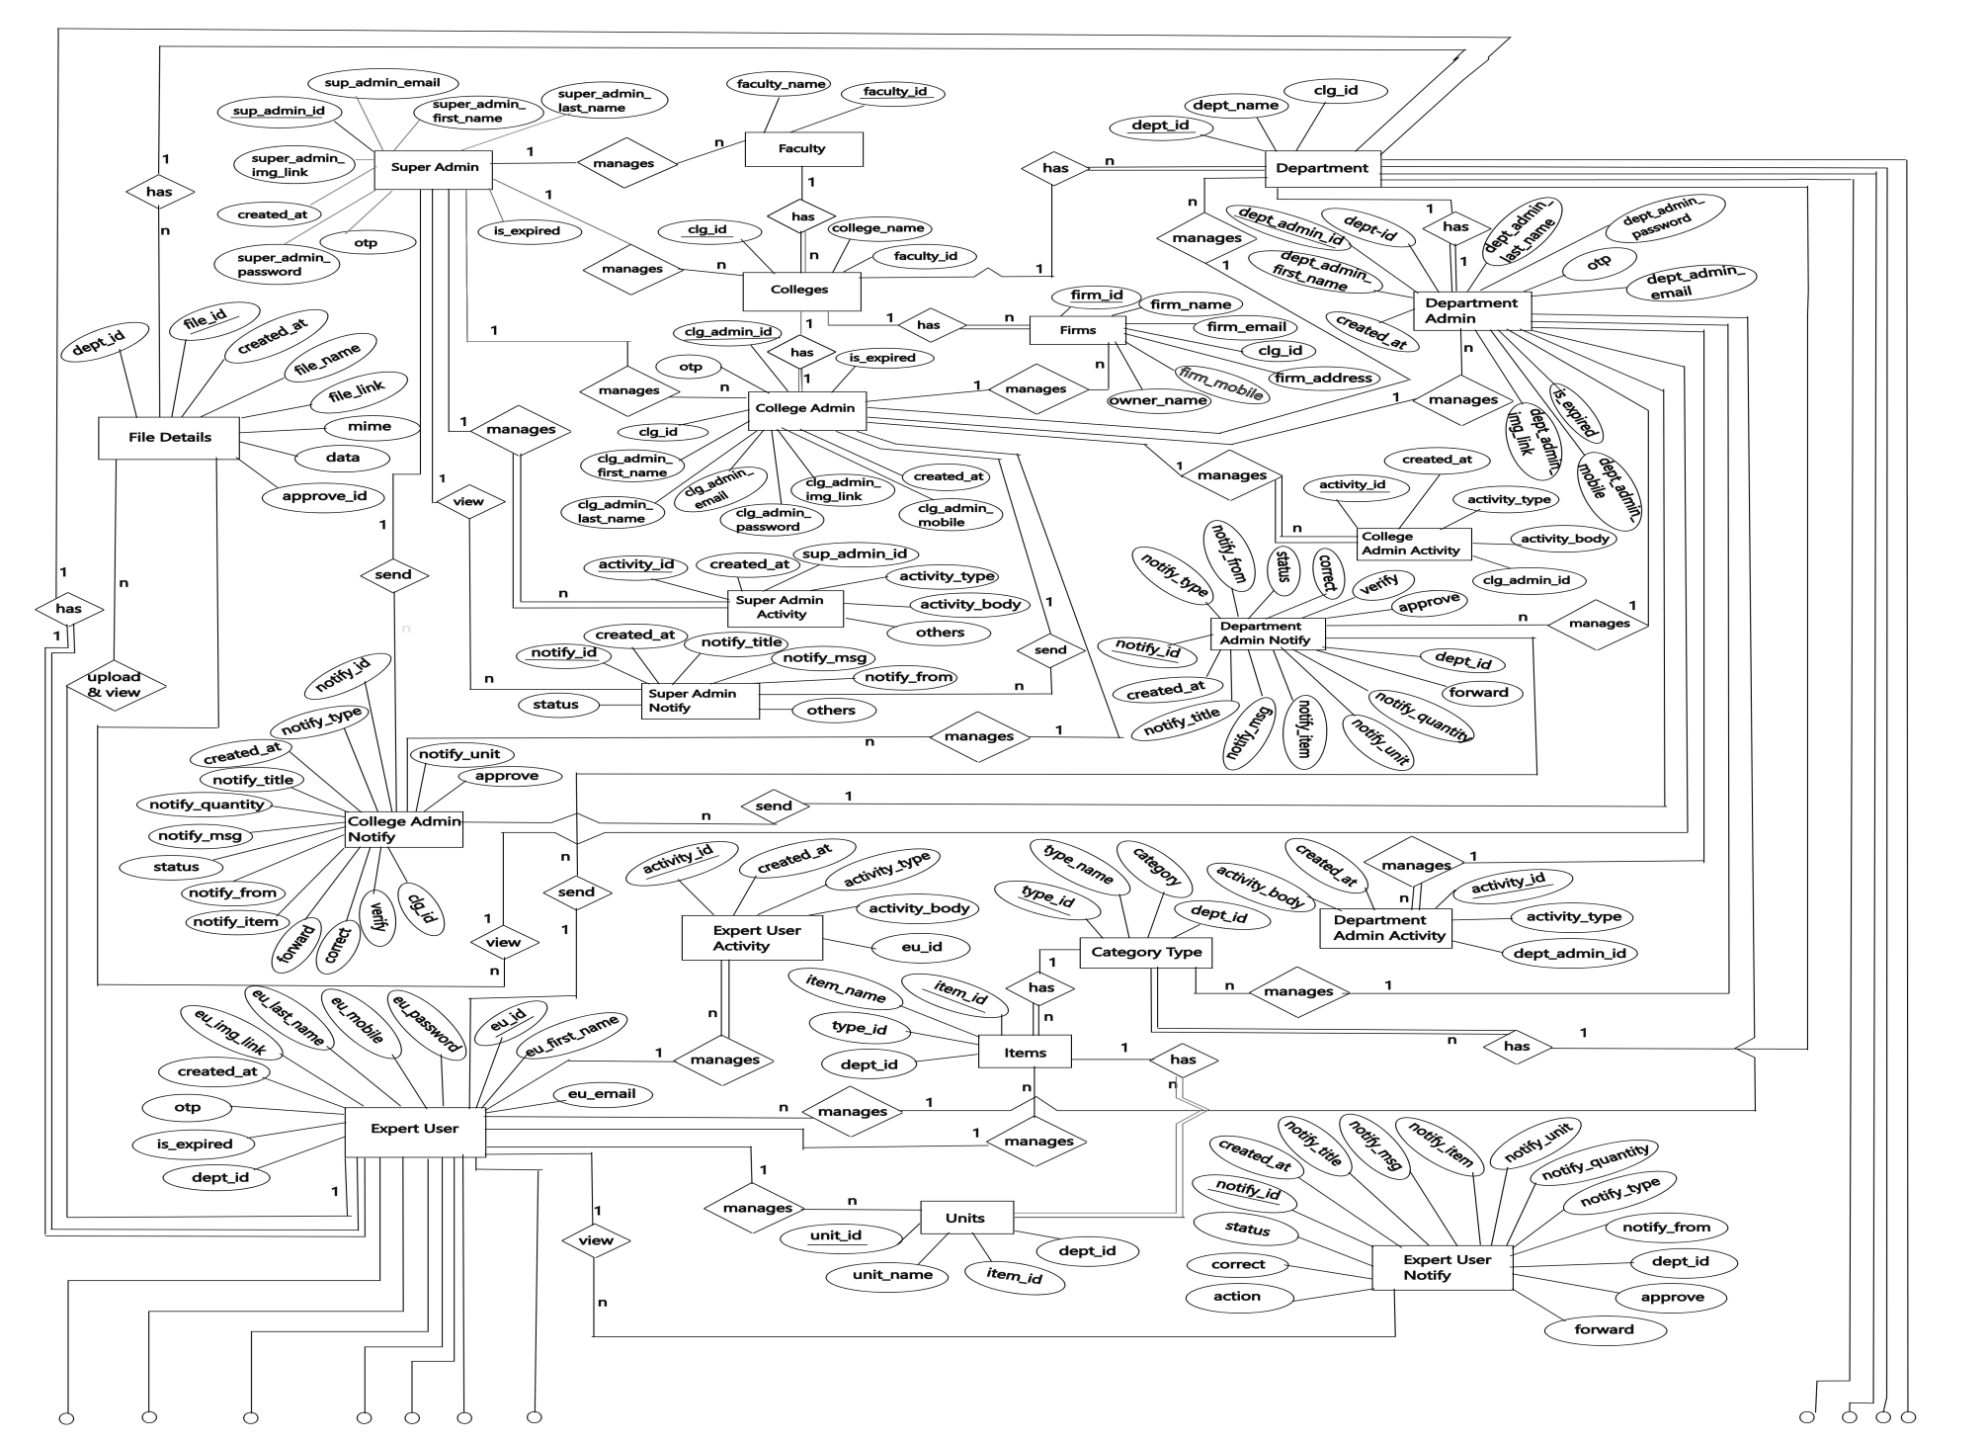

Slide 9
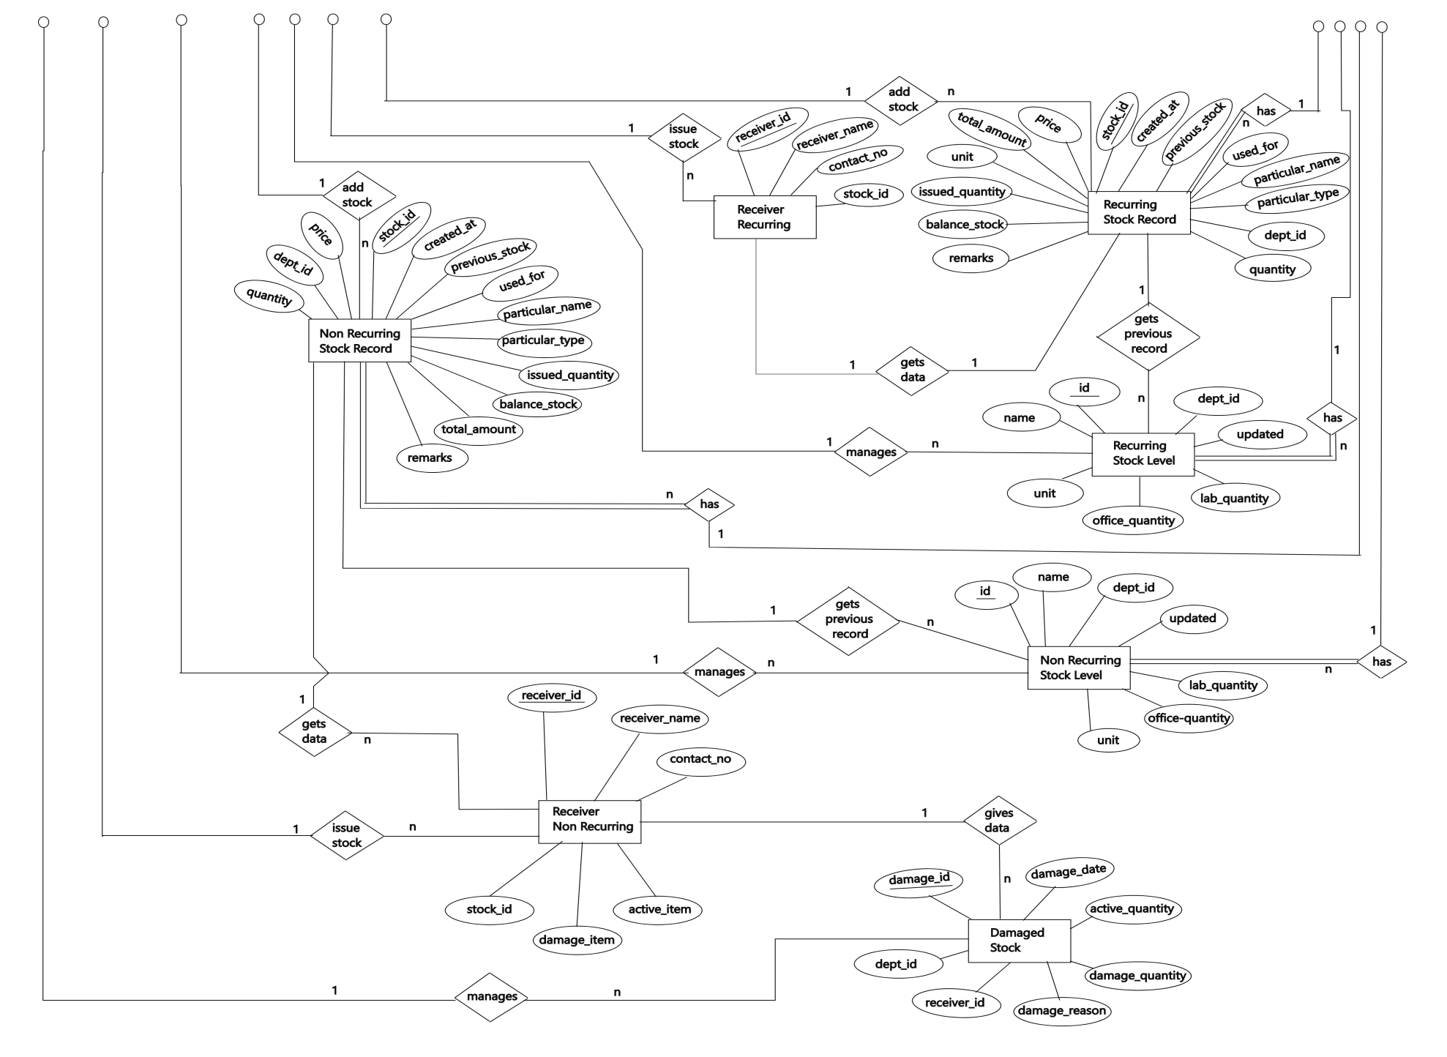

Slide 10
RELATIONAL MODEL PK – PRIMARY KEY FK – FOREIGN KEY

Slide 11
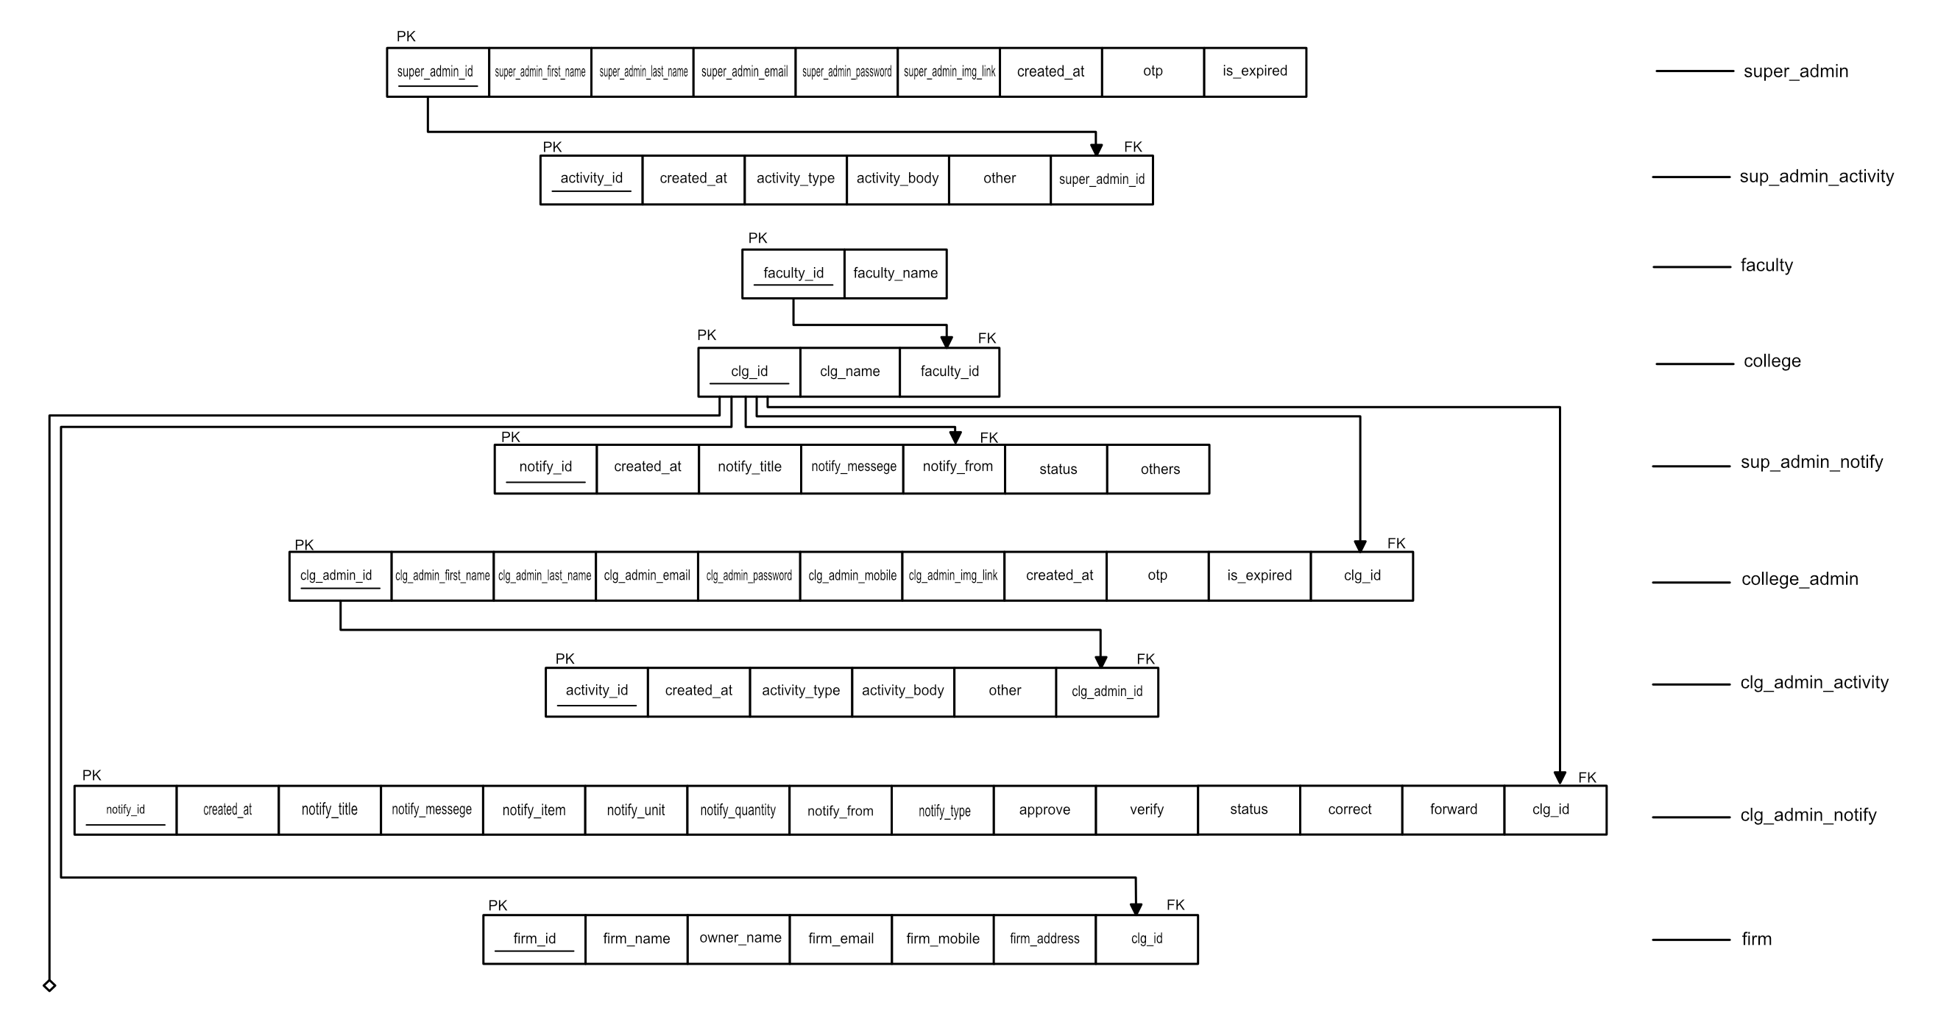

Slide 12
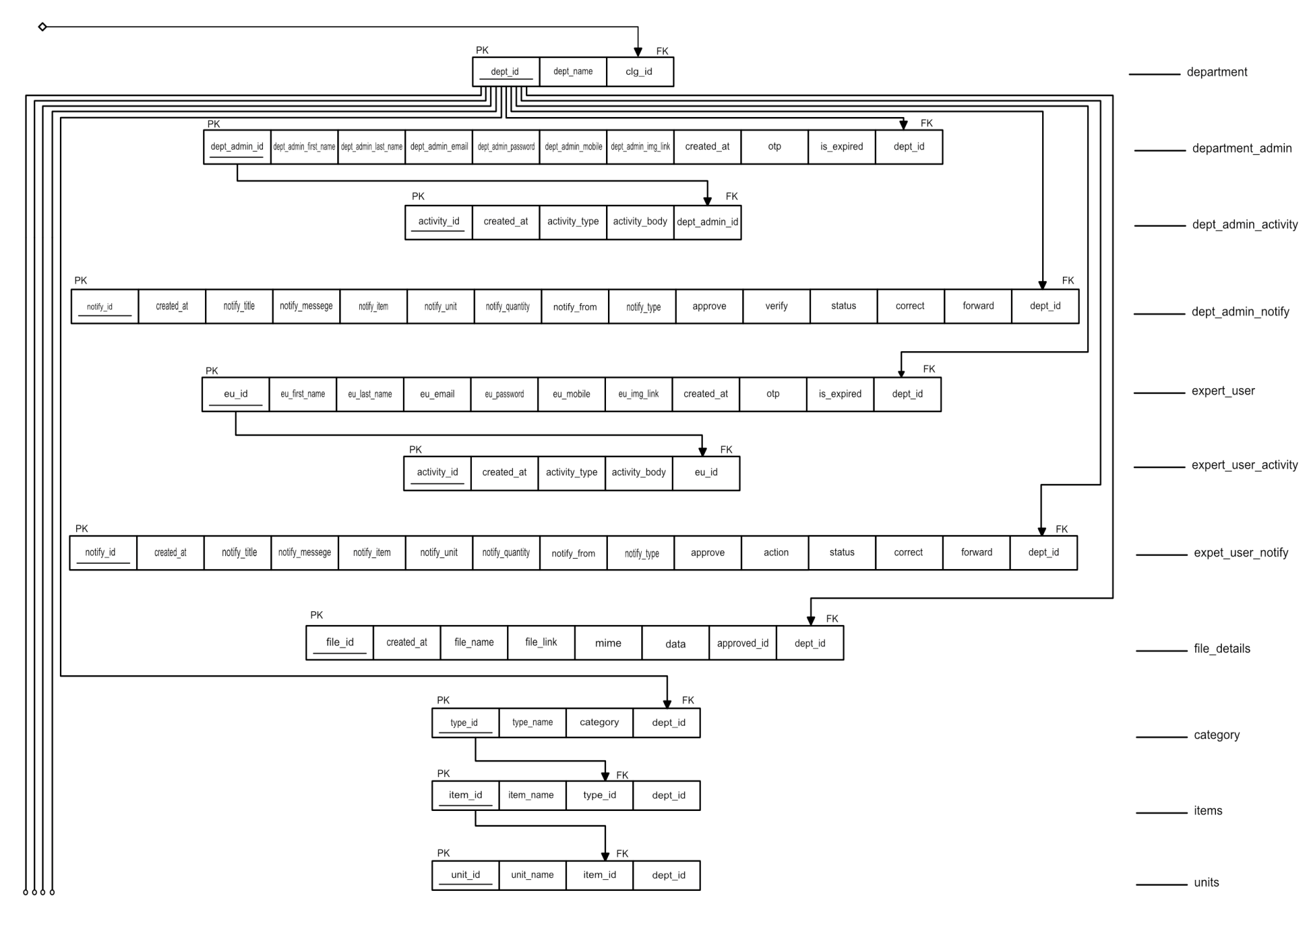

Slide 13
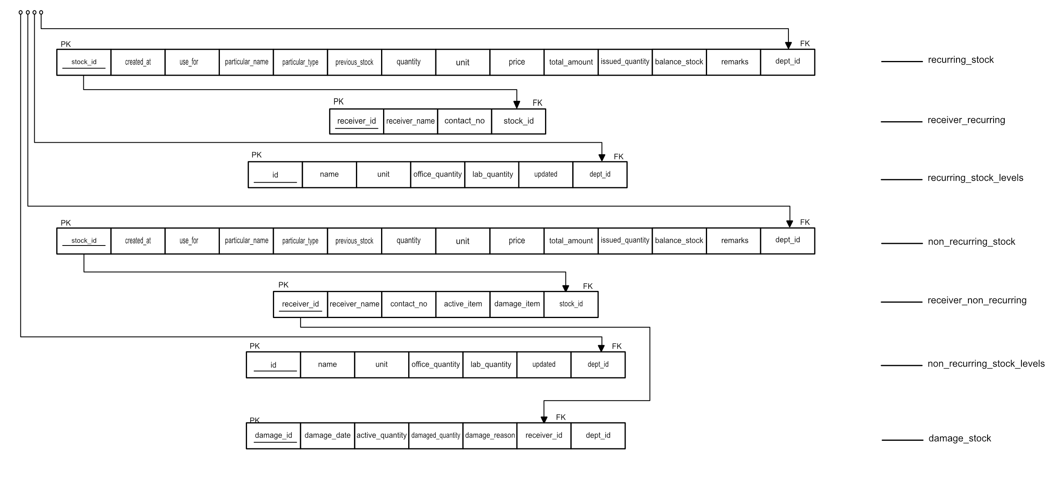

Slide 14
DATA FLOW DIAGRAM

Slide 15
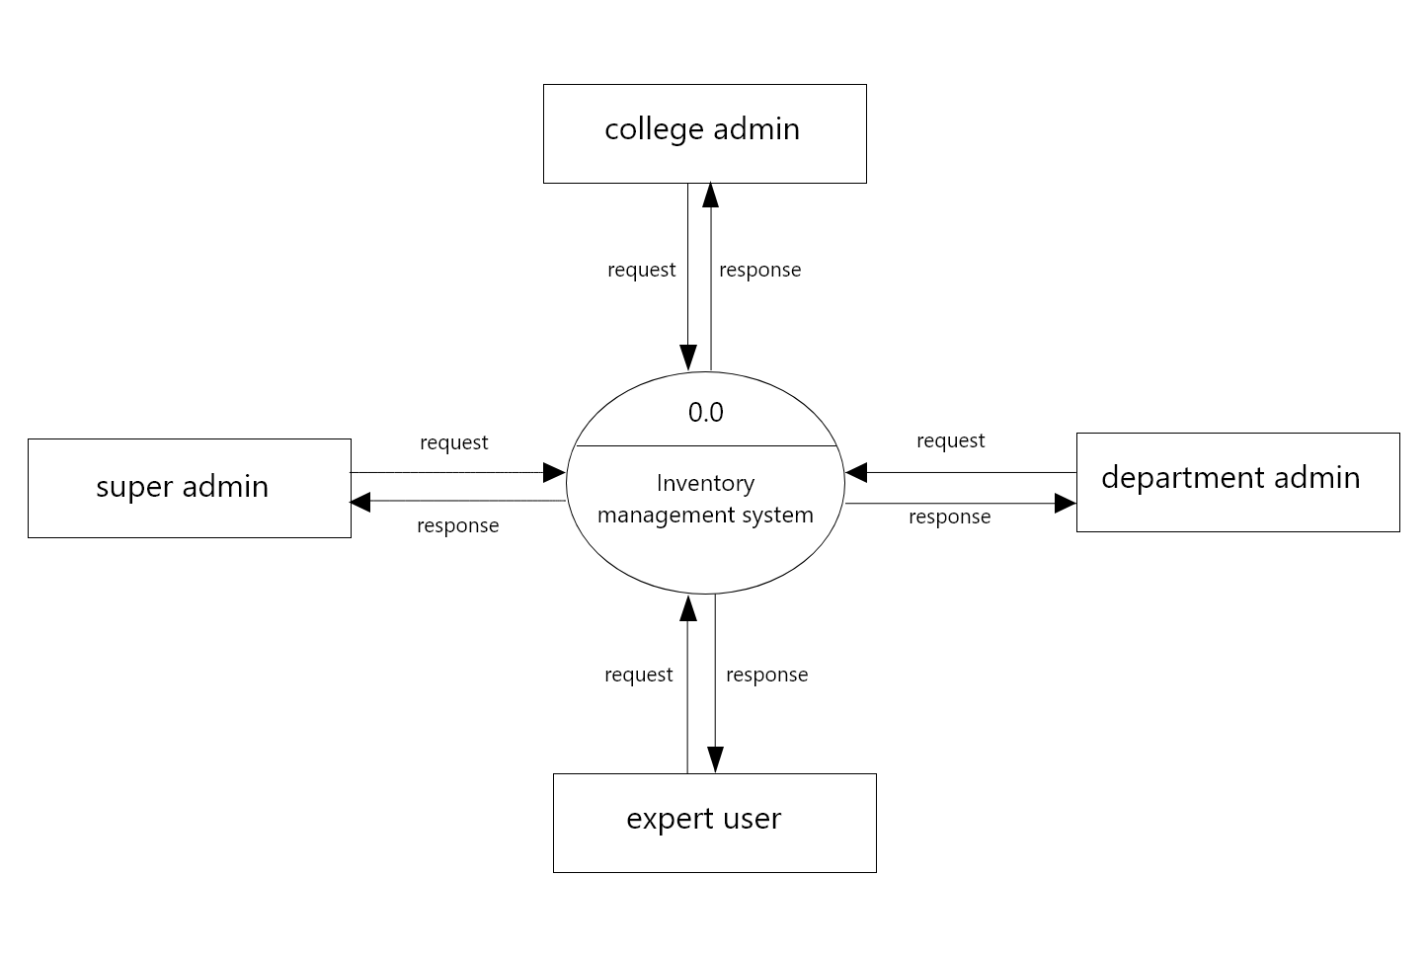
Fig: Level 0 DFD

Slide 16
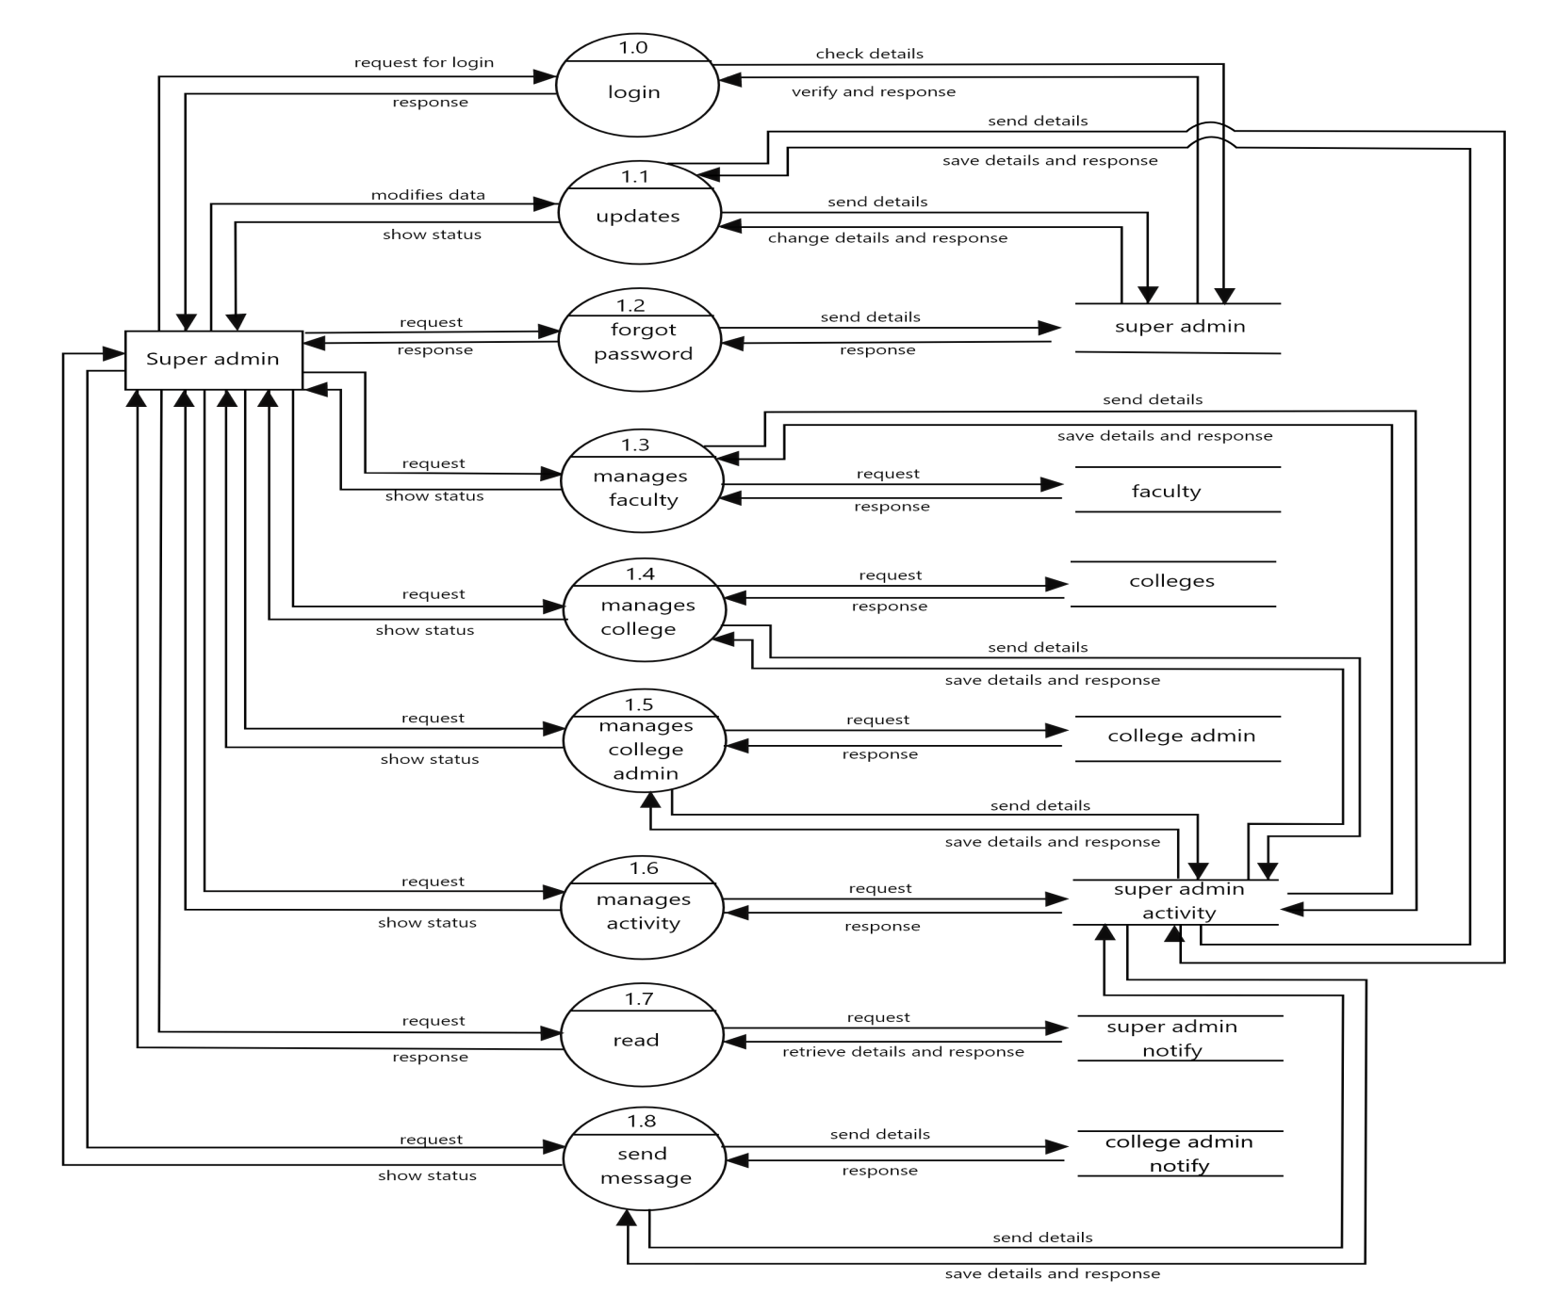
Fig: Level 1 DFD for super admin

Slide 17
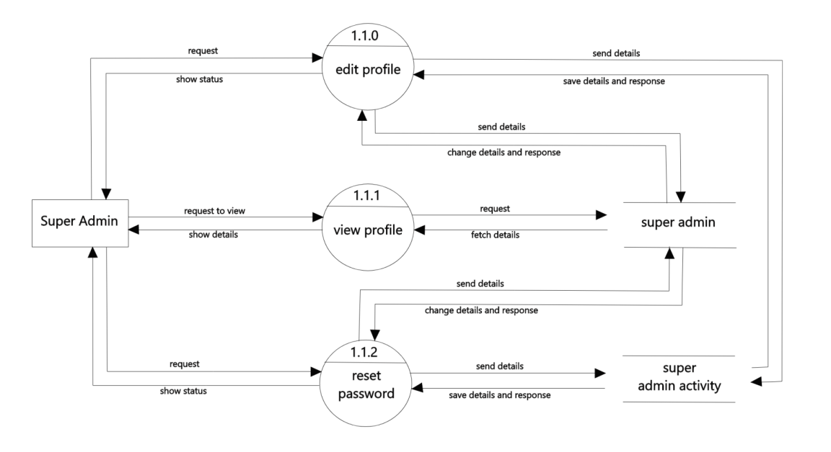
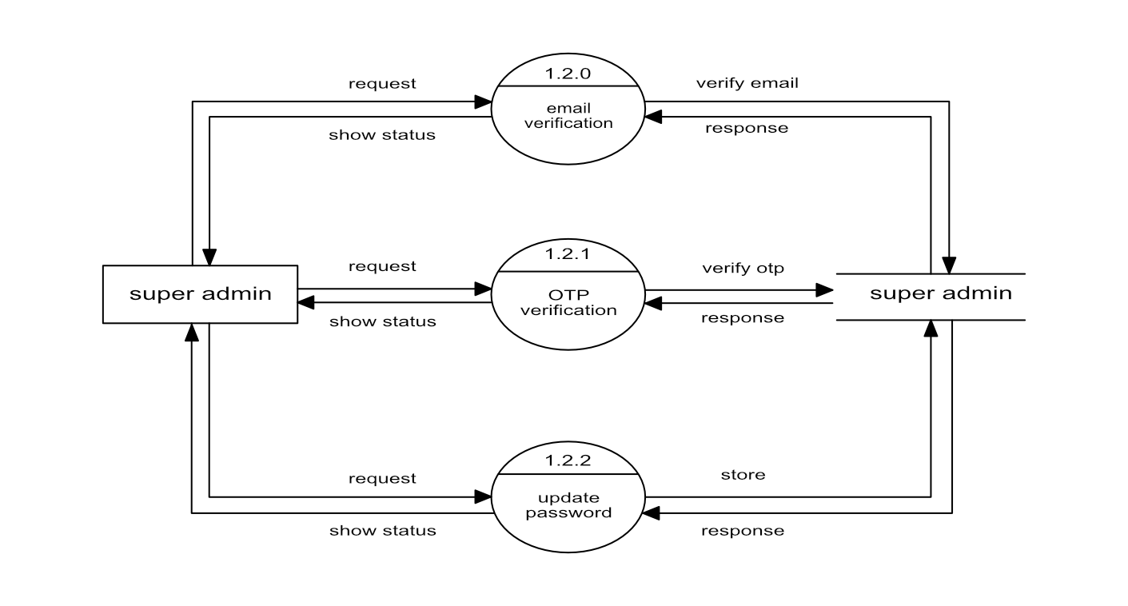
Fig: Level 2 DFD for super admin(updates)
Fig: Level 2 DFD for super admin(forgot password)

Slide 18
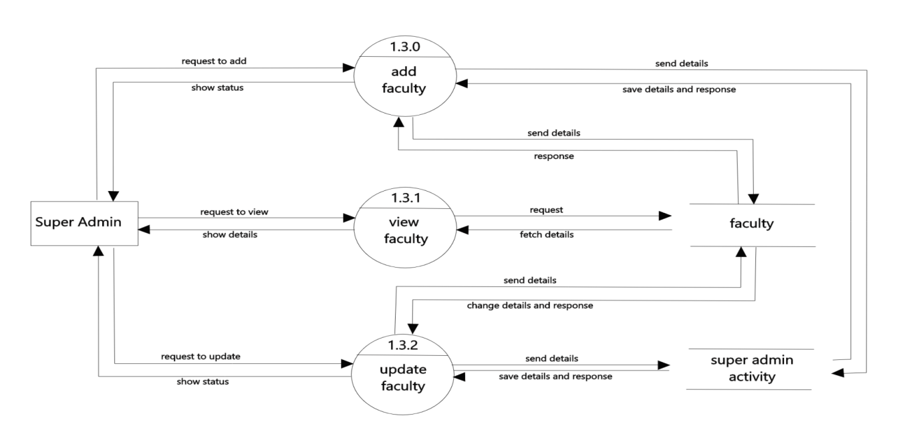
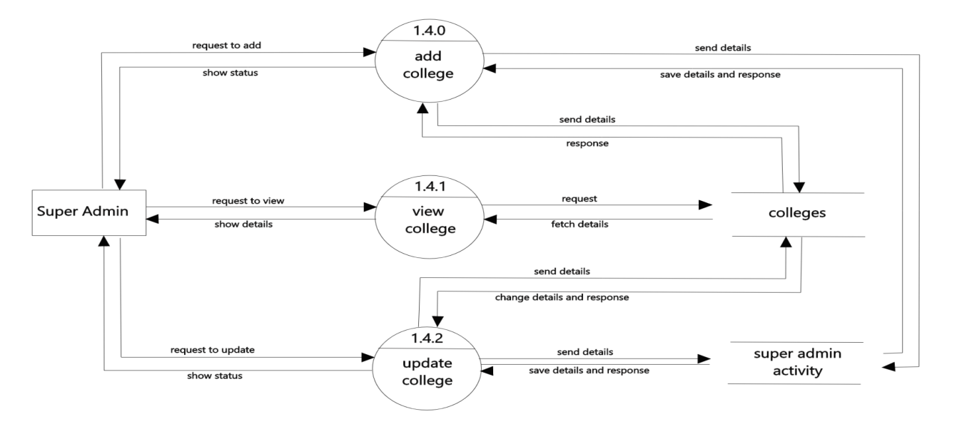
Fig: Level 2 DFD for super admin(manages faculty)
Fig: Level 2 DFD for super admin(manages college)

Slide 19
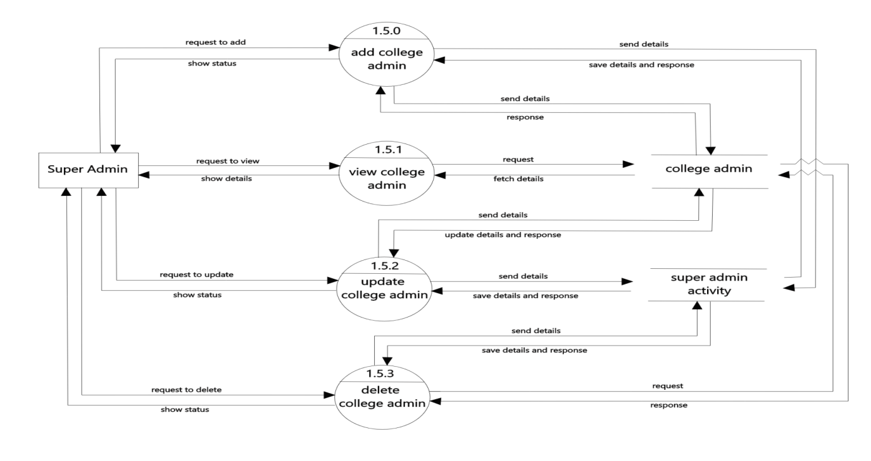
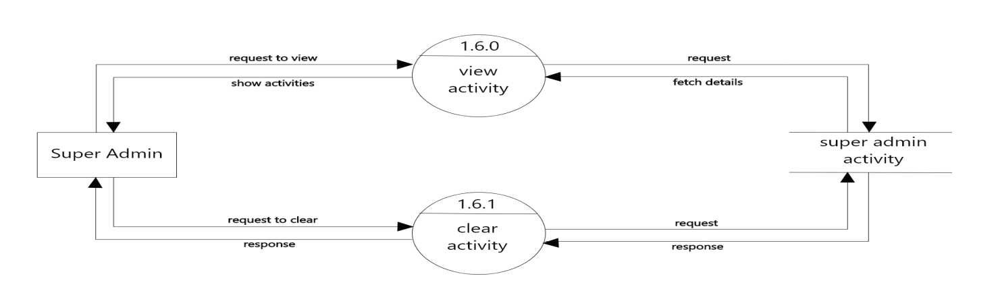
Fig: Level 2 DFD for super admin(manages college admin)
Fig: Level 2 DFD for super admin(manages activity)

Slide 20
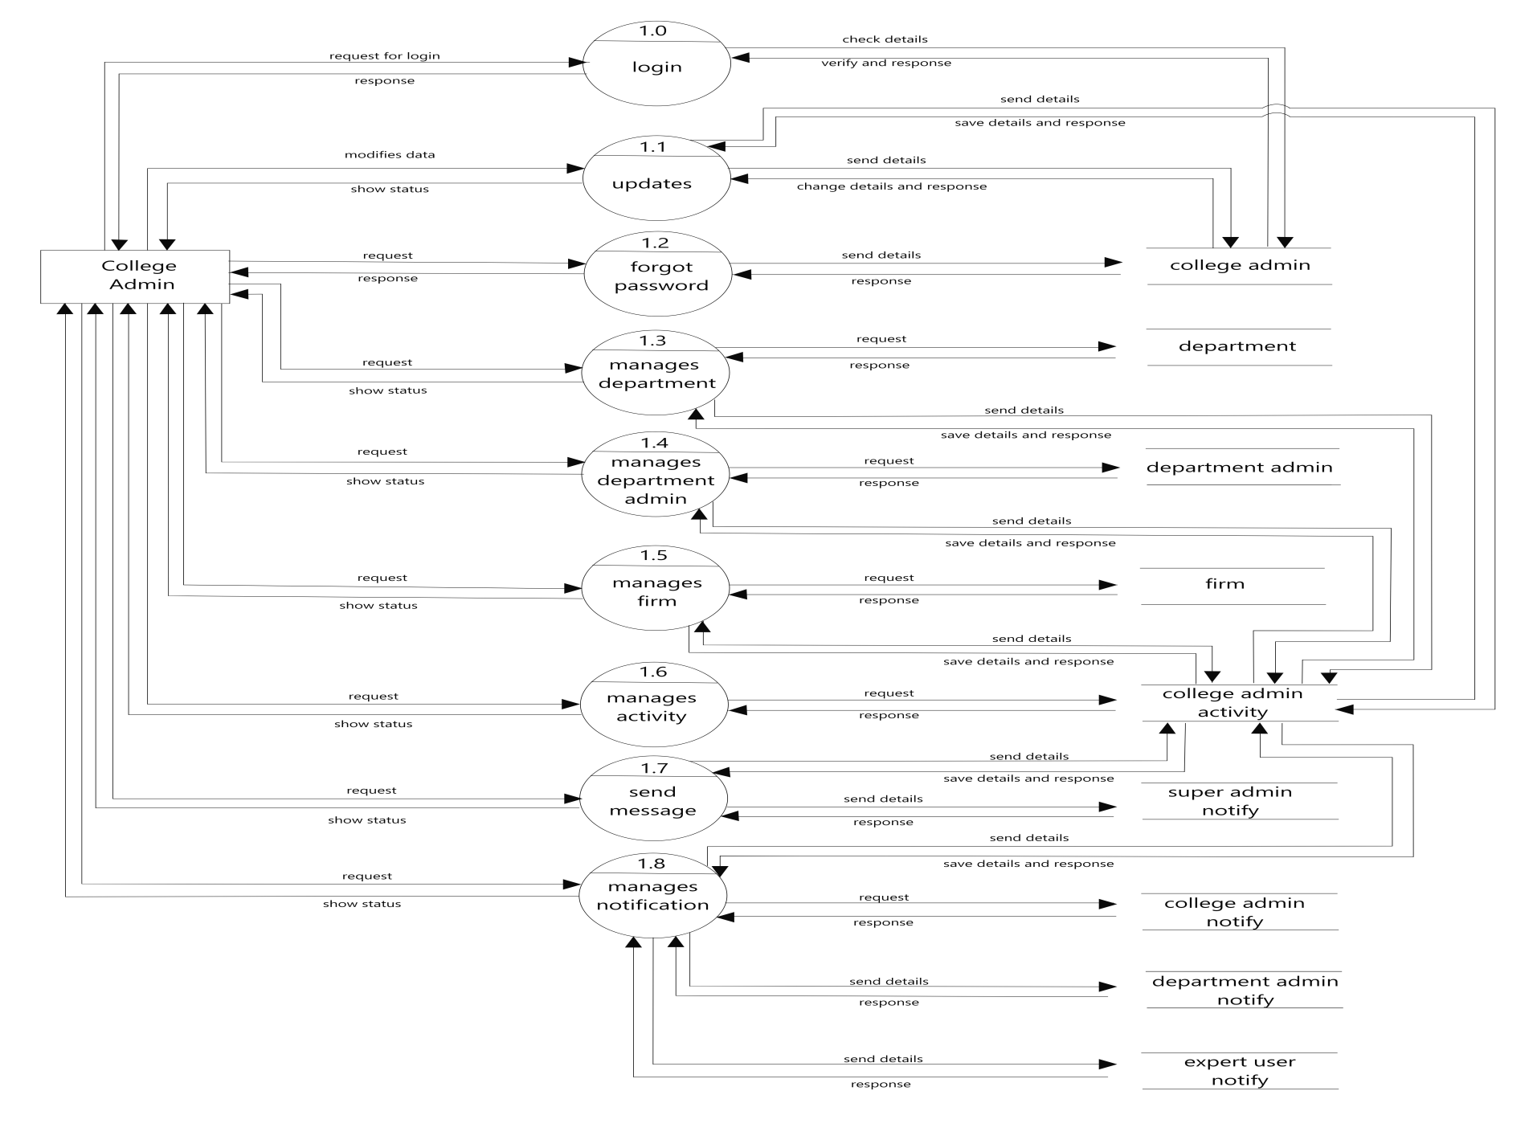
Fig: Level 1 DFD for college admin

Slide 21
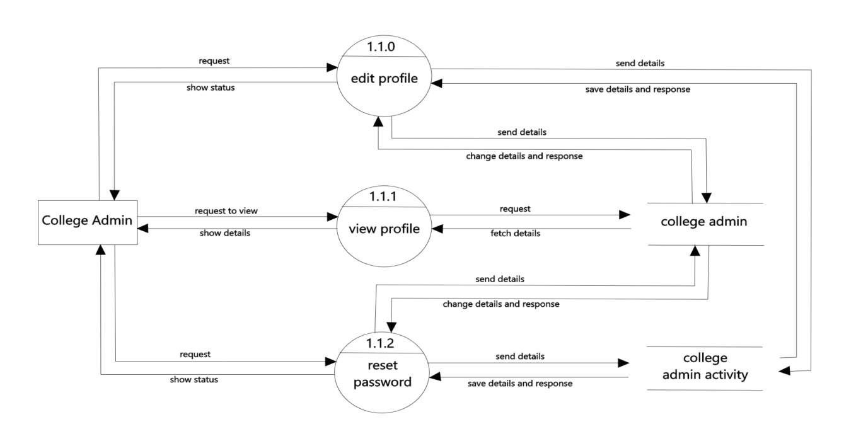

Fig: Level 2 DFD for college admin(updates)
Fig: Level 2 DFD for college admin(forgot password)

Slide 22
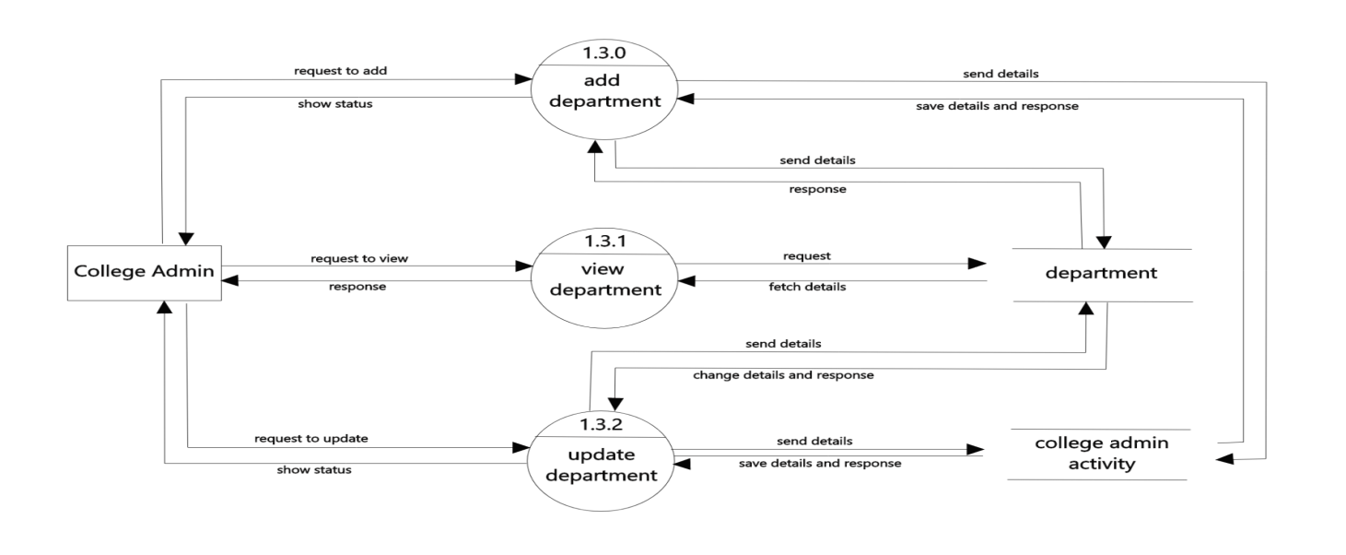
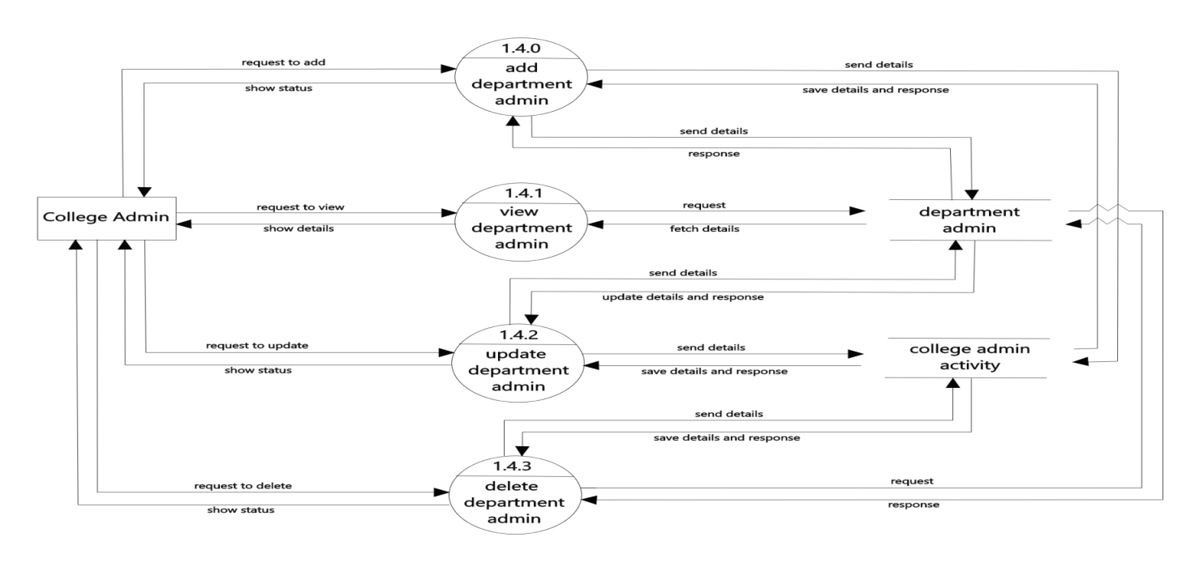
Fig: Level 2 DFD for college admin(manages department)
Fig: Level 2 DFD for college admin(manages department admin)

Slide 23
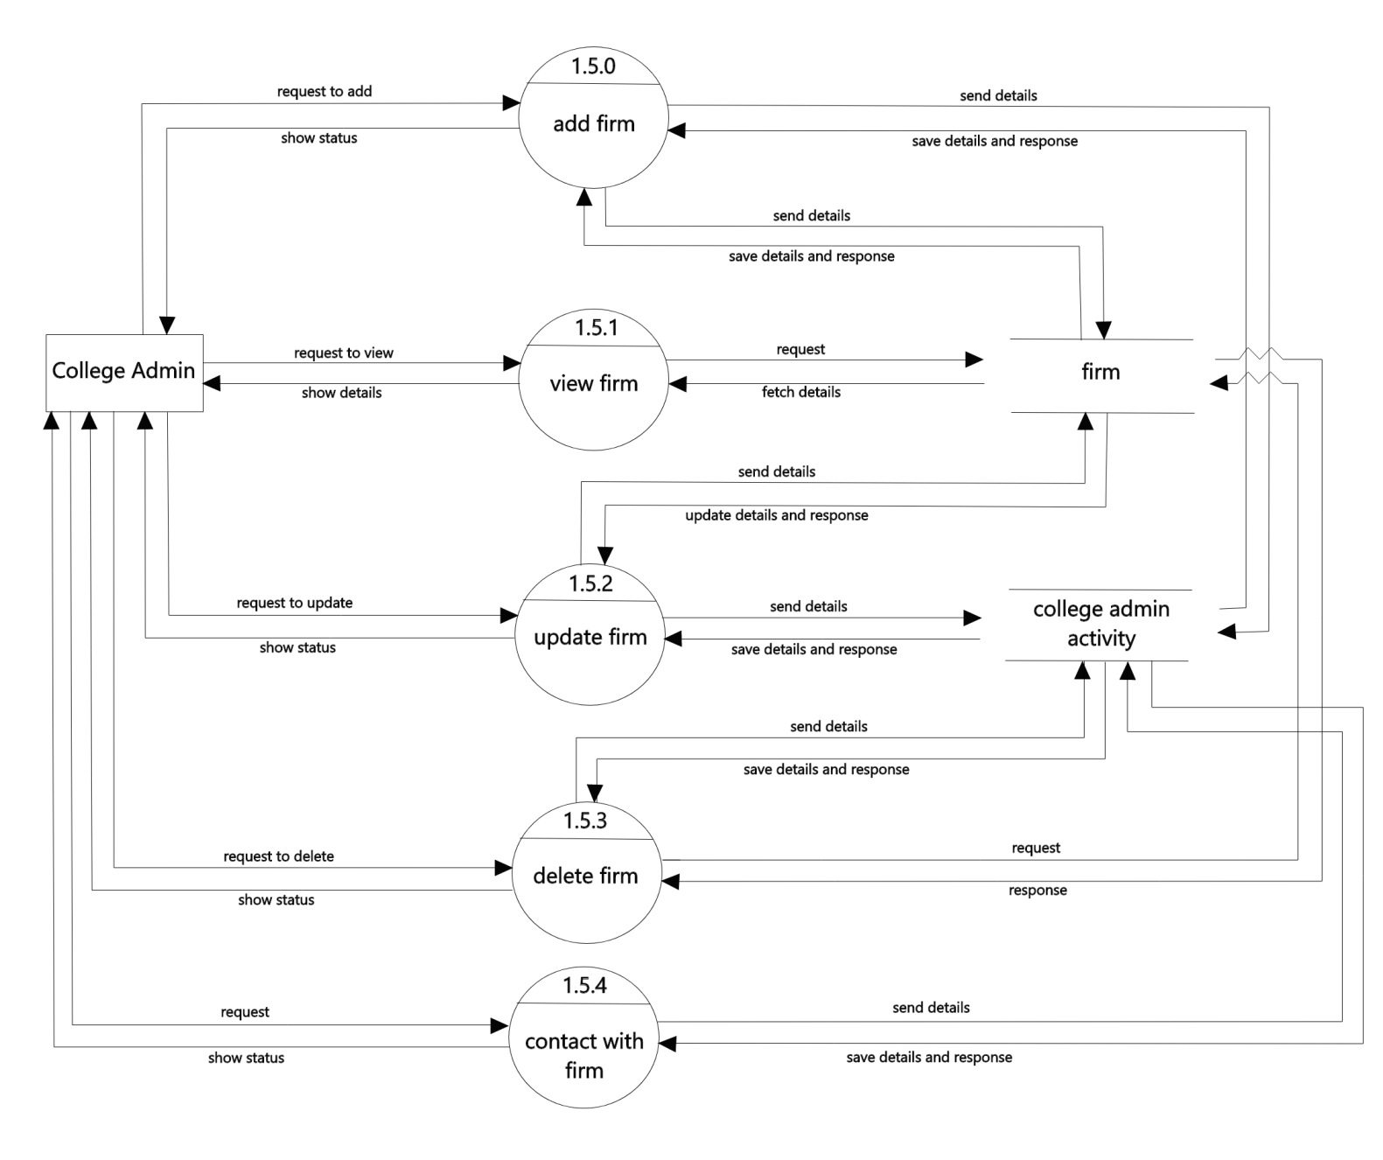
Fig: Level 2 DFD for college admin(manages firm)

Slide 24
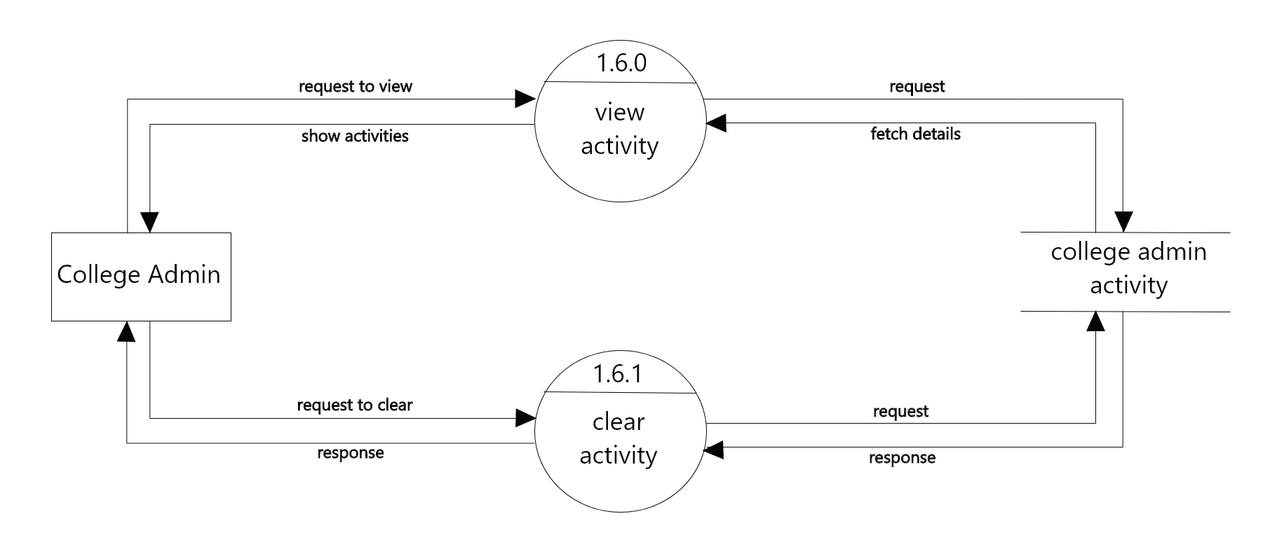
Fig: Level 2 DFD for college admin(manages activity)

Slide 25
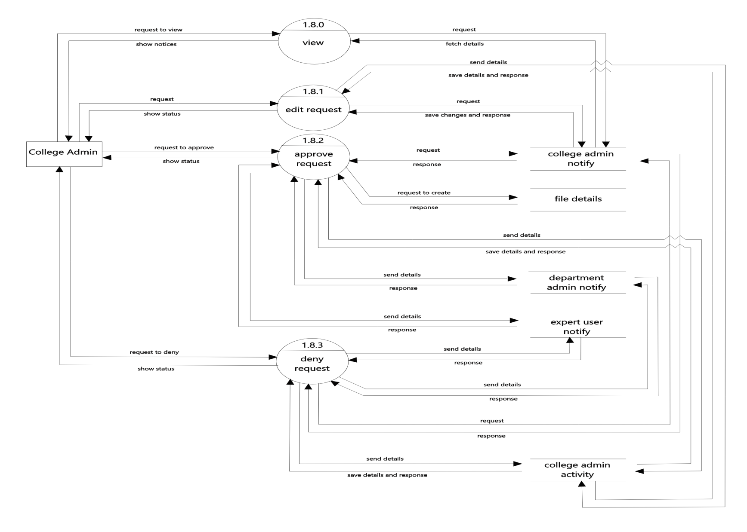
Fig: Level 2 DFD for college admin(manages notification)

Slide 26
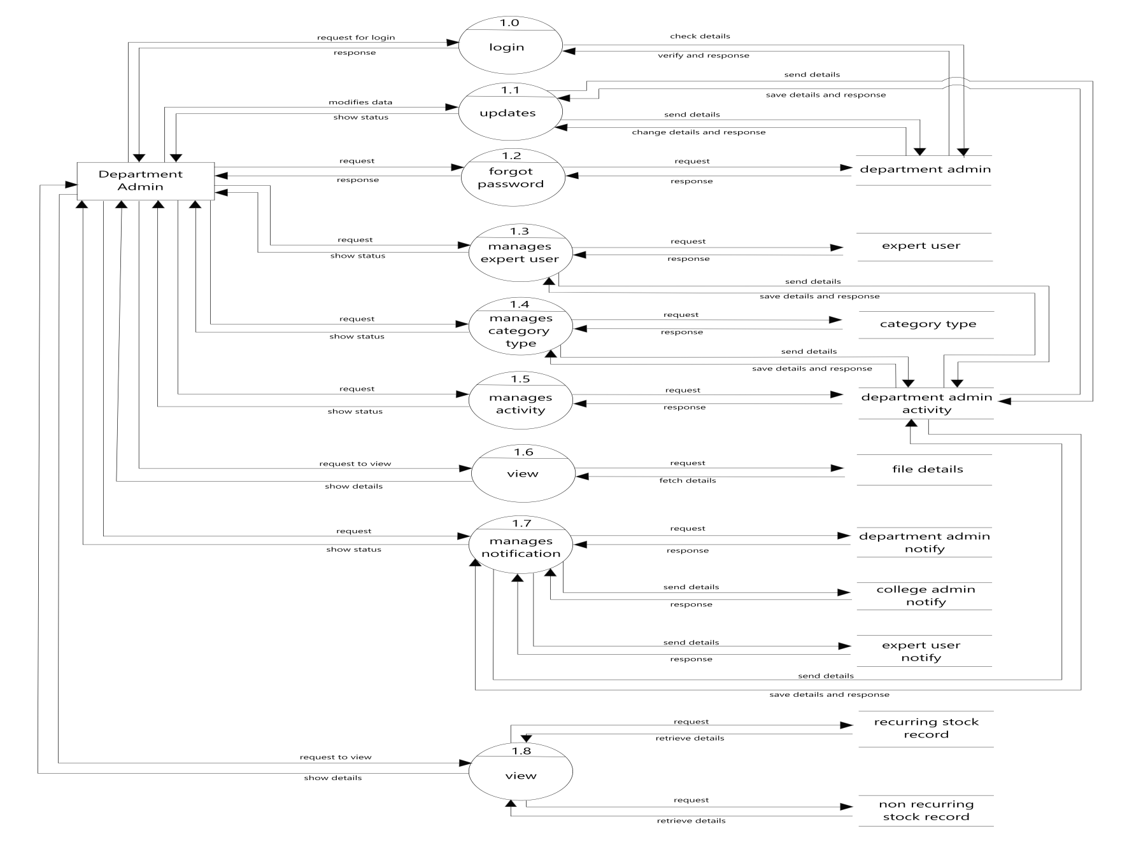
Fig: Level 1 DFD for department admin

Slide 27
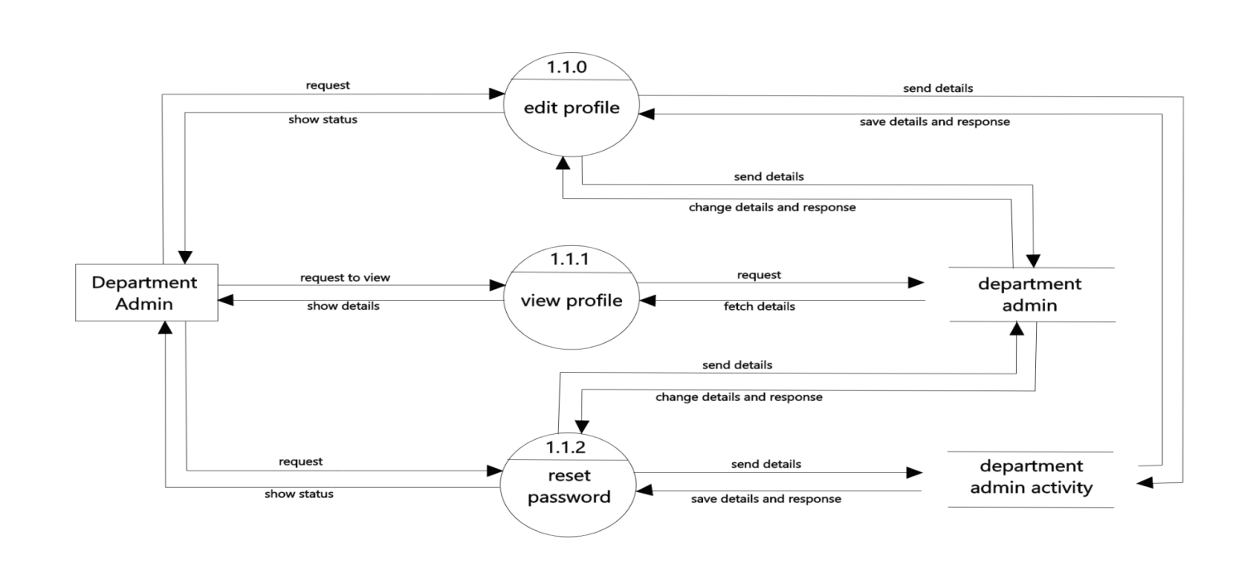
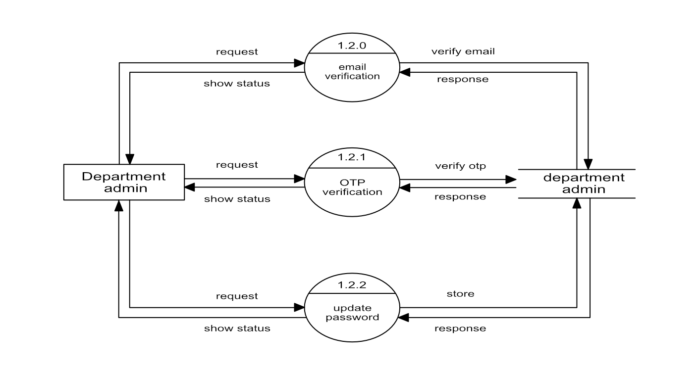
Fig: Level 2 DFD for department admin(updates)
Fig: Level 2 DFD for department admin(forgot password)

Slide 28
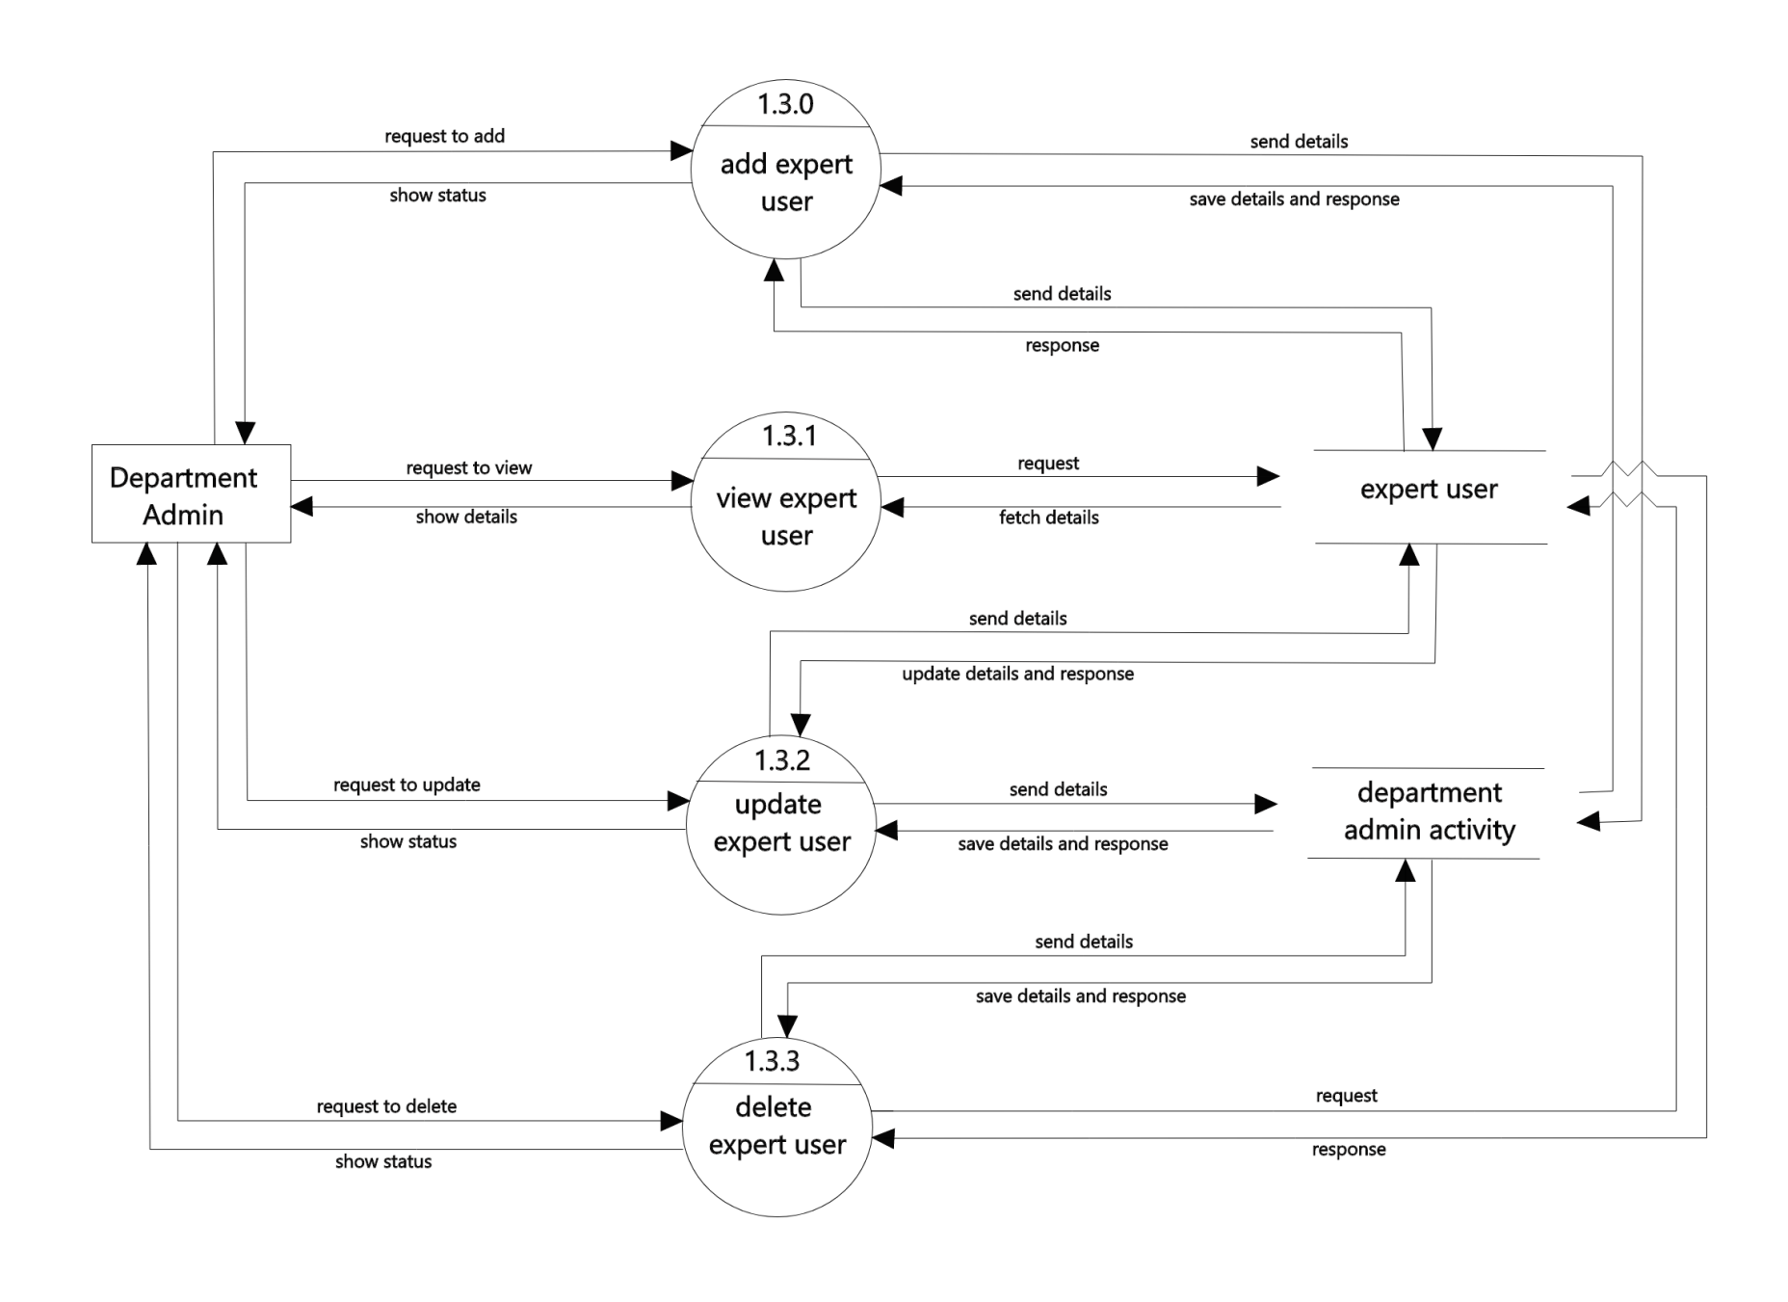
Fig: Level 2 DFD for department admin(manages expert user)

Slide 29
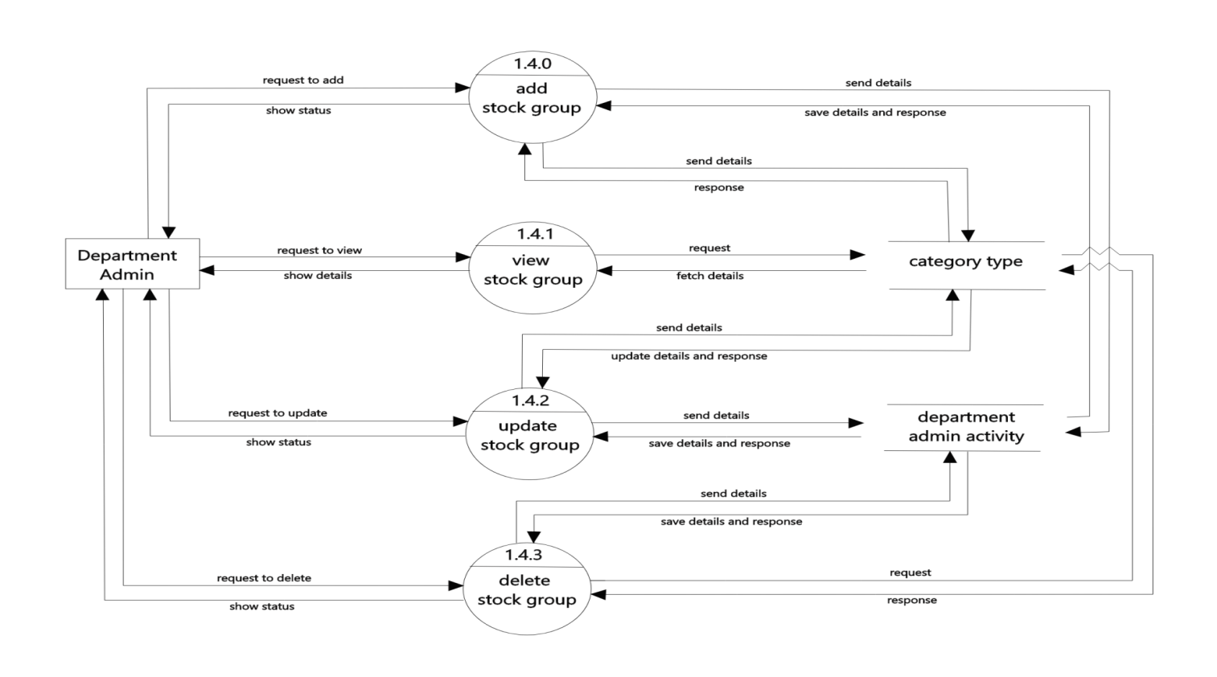
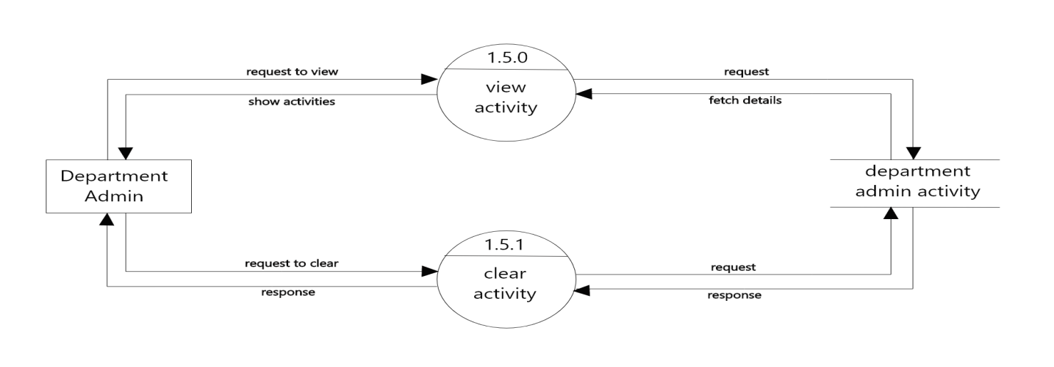
Fig: Level 2 DFD for department admin(manages stock group)
Fig: Level 2 DFD for department admin(manages activity)

Slide 30
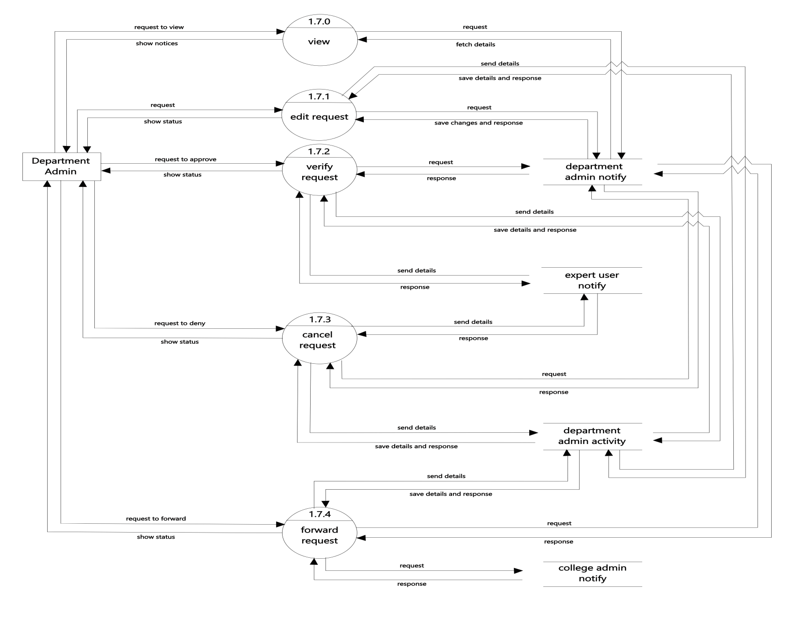
Fig: Level 2 DFD for department admin(manages notification)

Slide 31
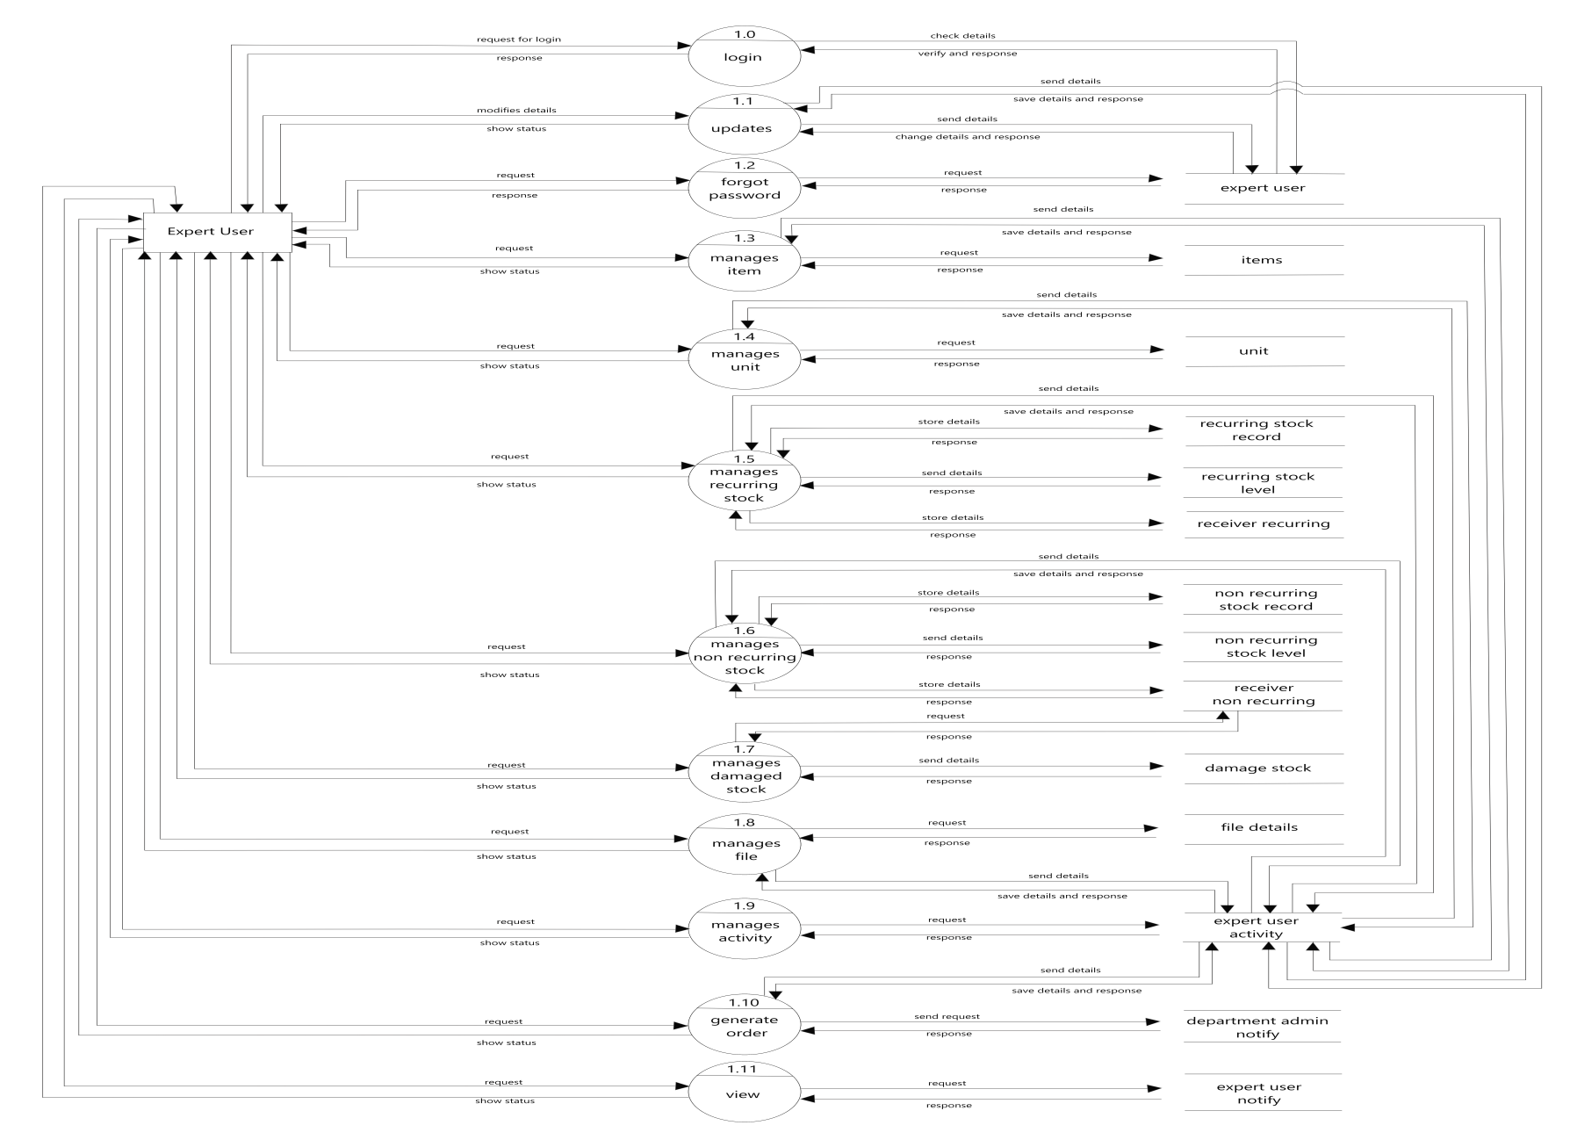
Fig: Level 1 DFD for expert user

Slide 32
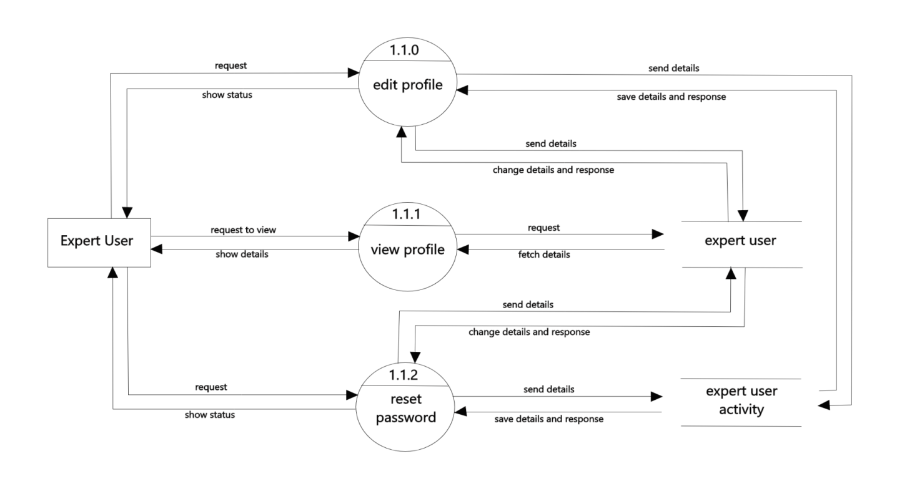
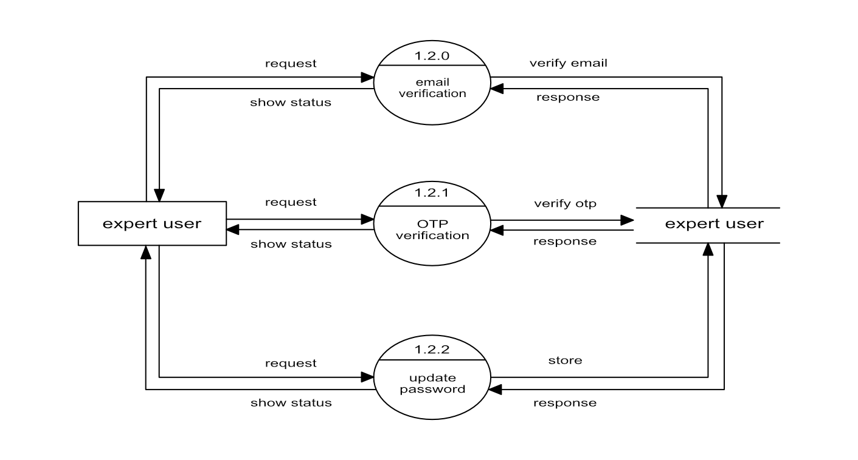
Fig: Level 2 DFD for expert user(updates)
Fig: Level 2 DFD for expert user(forgot password)

Slide 33
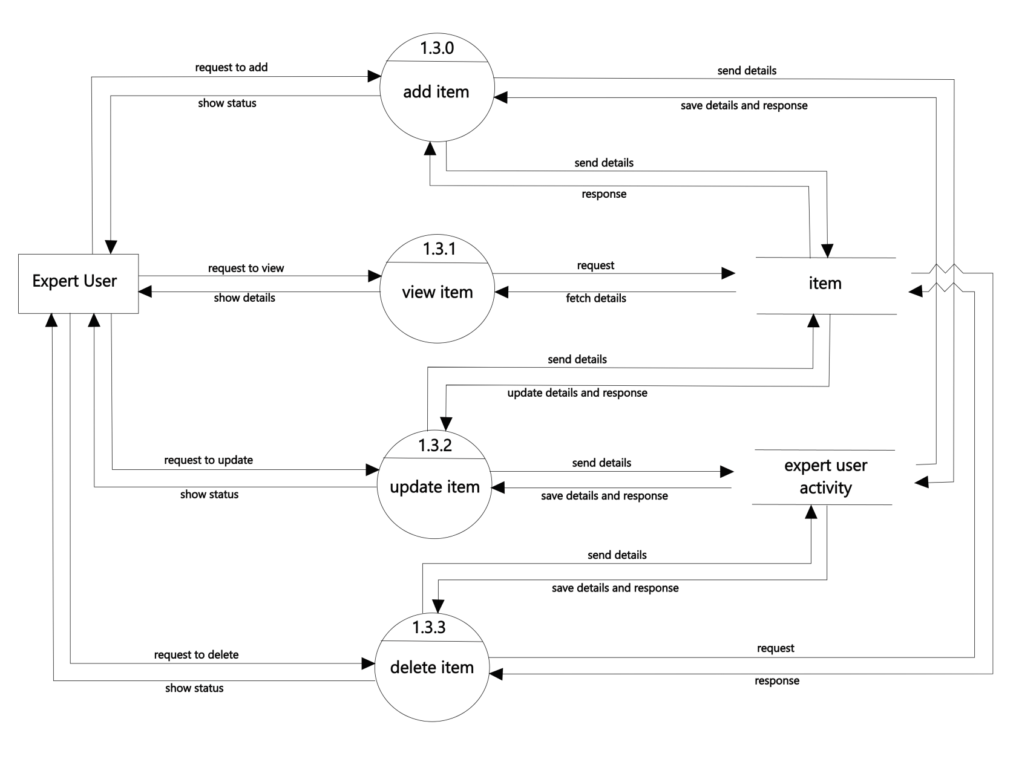
Fig: Level 2 DFD for expert user(manages item)

Slide 34
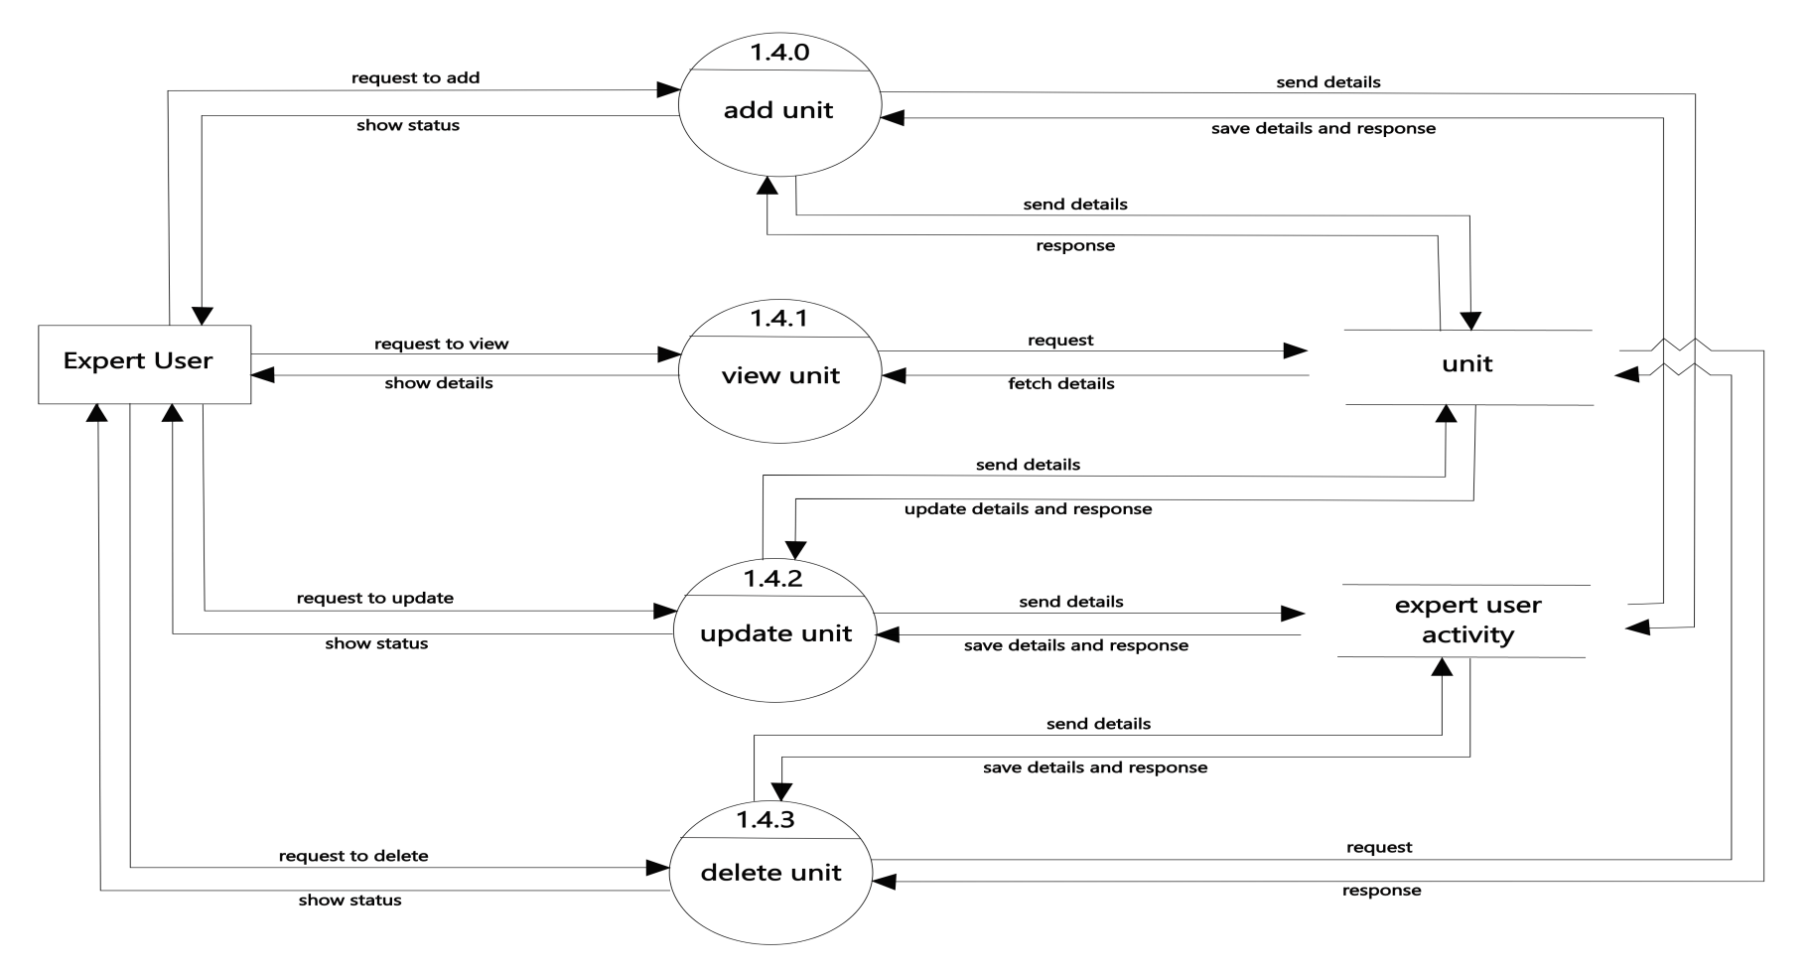
Fig: Level 2 DFD for expert user(manages unit)

Slide 35
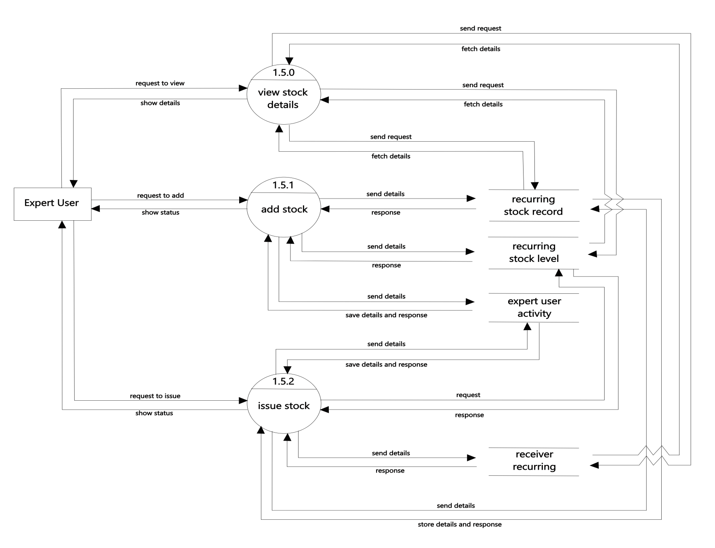
Fig: Level 2 DFD for expert user(manages recurring stock)

Slide 36

Fig: Level 2 DFD for expert user(manages non recurring stock)

Slide 37
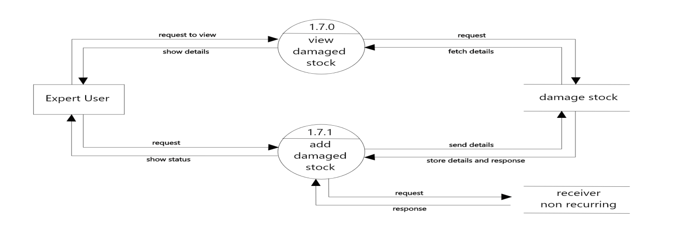
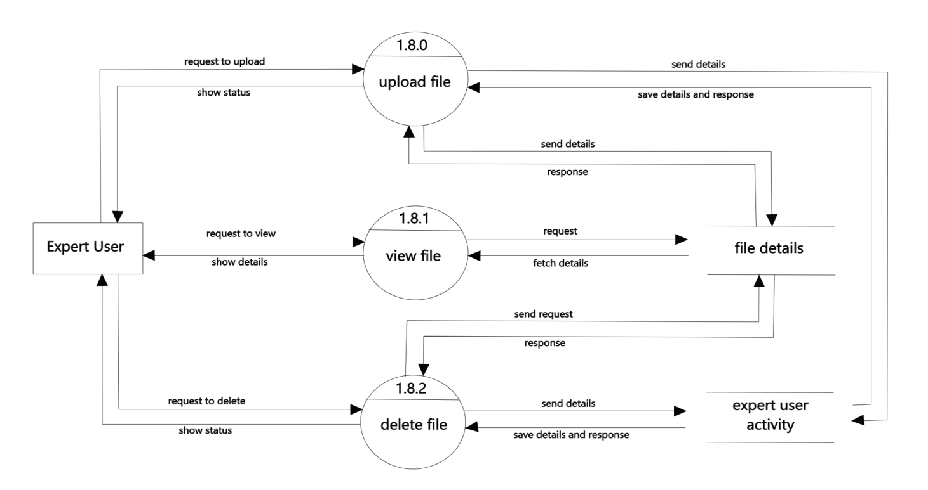
Fig: Level 2 DFD for expert user(manages damage stock)
Fig: Level 2 DFD for expert user(manages file)

Slide 38
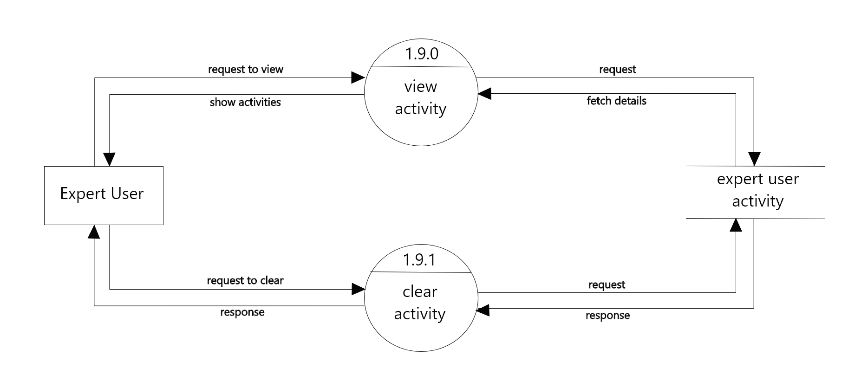
Fig: Level 2 DFD for expert user(manages activity)

Slide 39
SNAPSHOTS

Slide 40
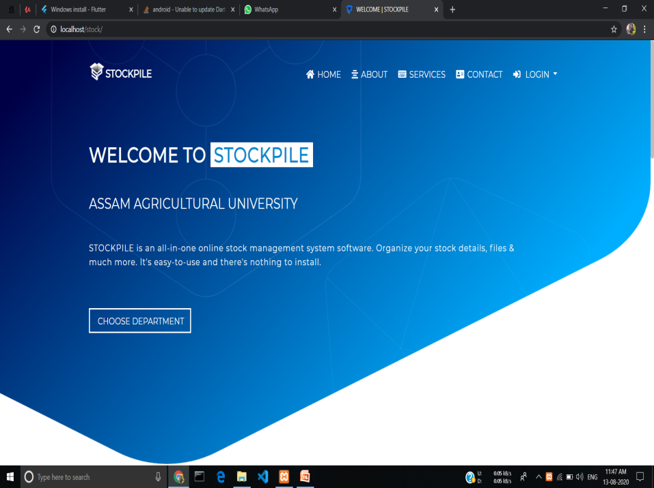
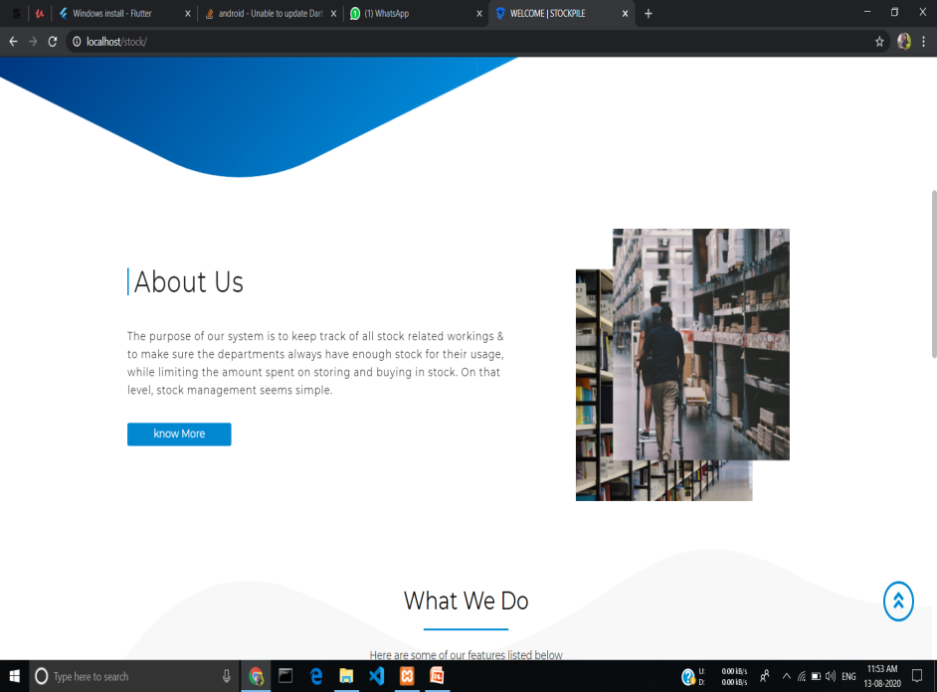
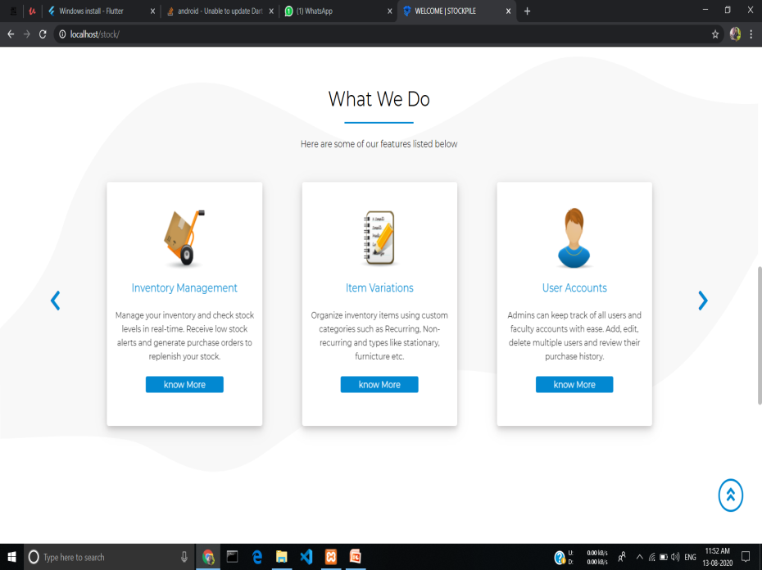
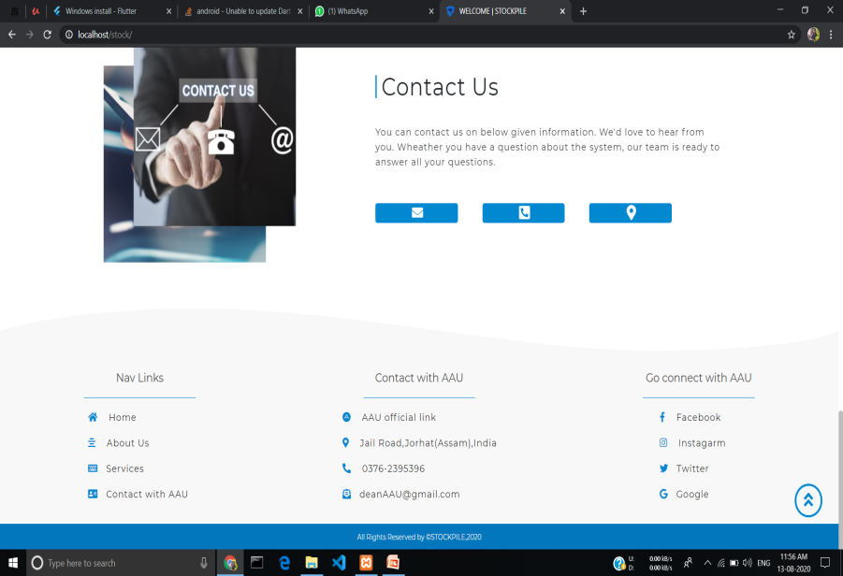
Fig: Snapshots of index page

Slide 41
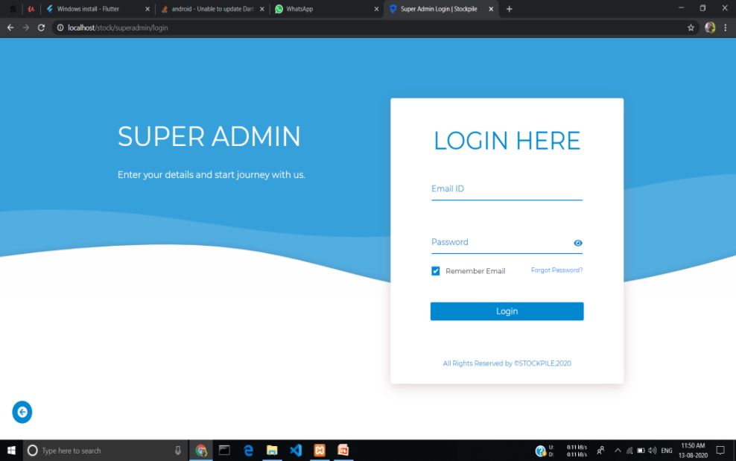
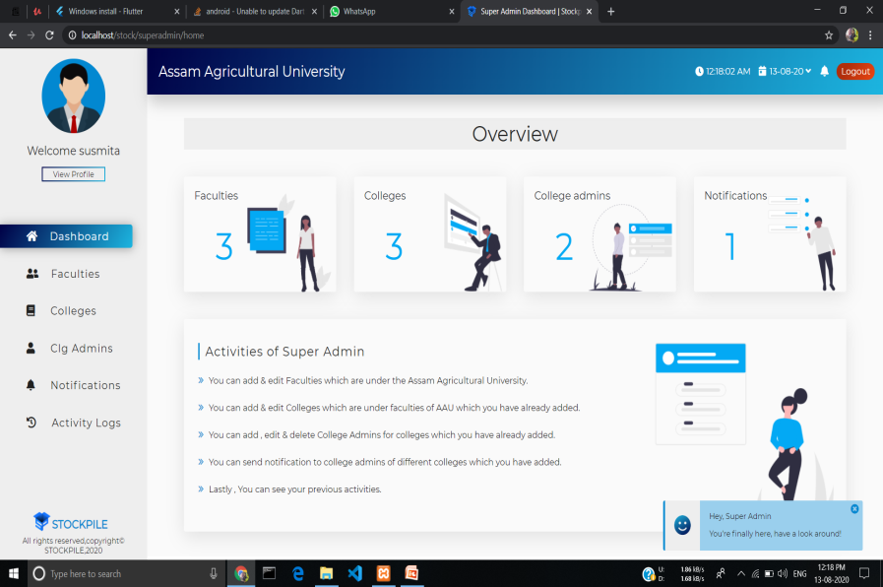
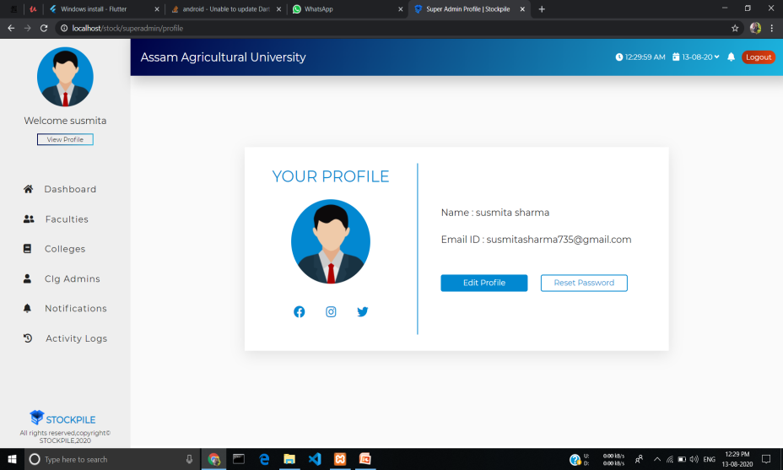
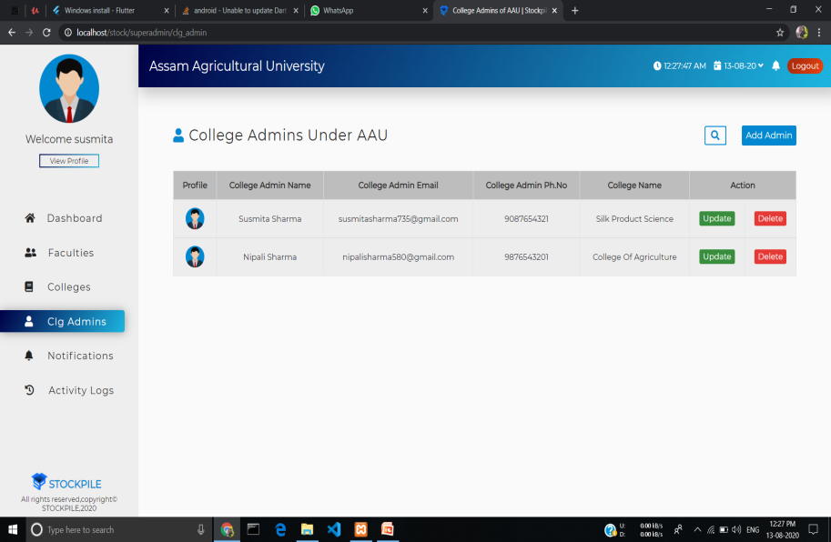
Fig: Snapshot of super admin login page
Fig: Snapshot of super admin dashboard tab
Fig: Snapshot of super admin profile tab
Fig: Snapshot of super admin clg admin tab

Slide 42
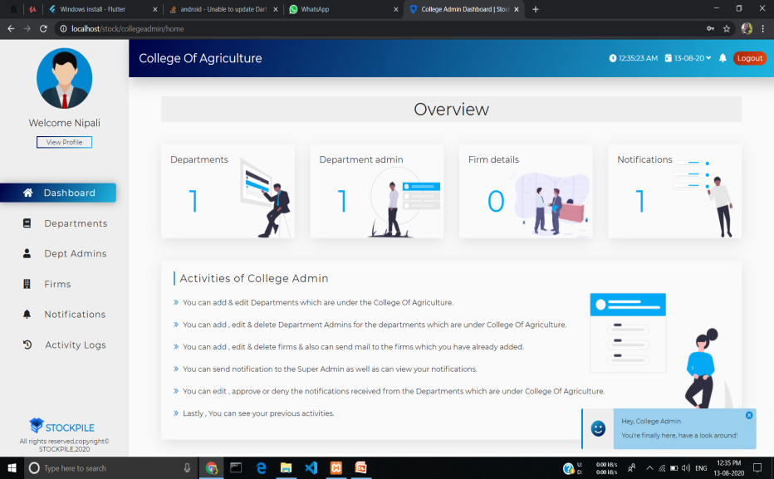
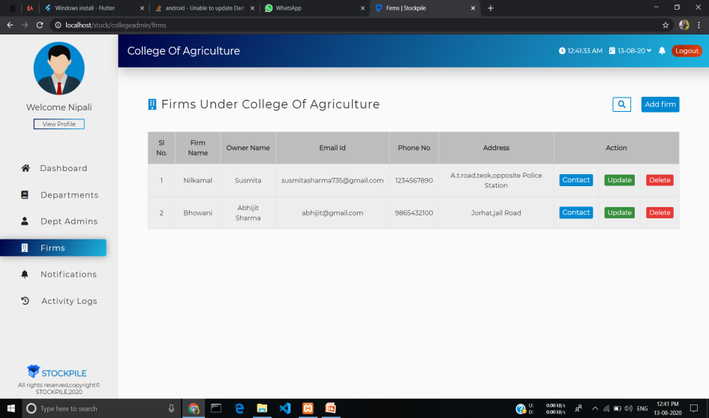
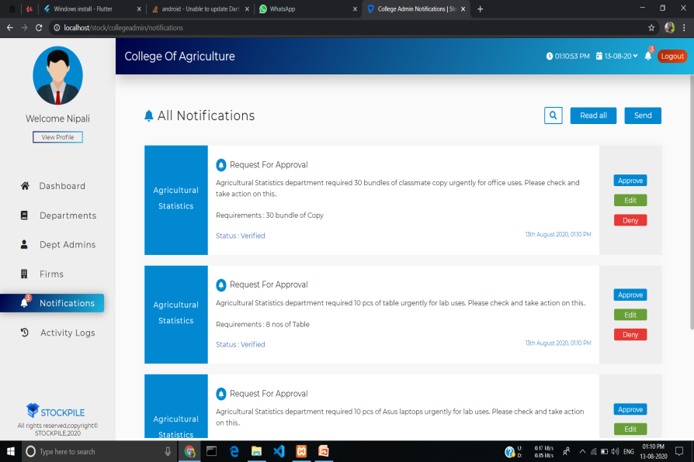
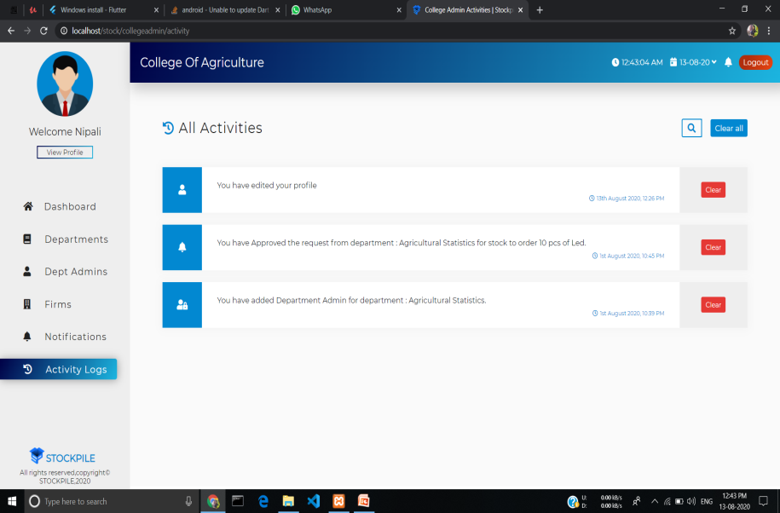
Fig: Snapshot of college admin dashboard tab
Fig: Snapshot of college admin firm tab
Fig: Snapshot of college admin notification tab
Fig: Snapshot of college admin activity tab

Slide 43
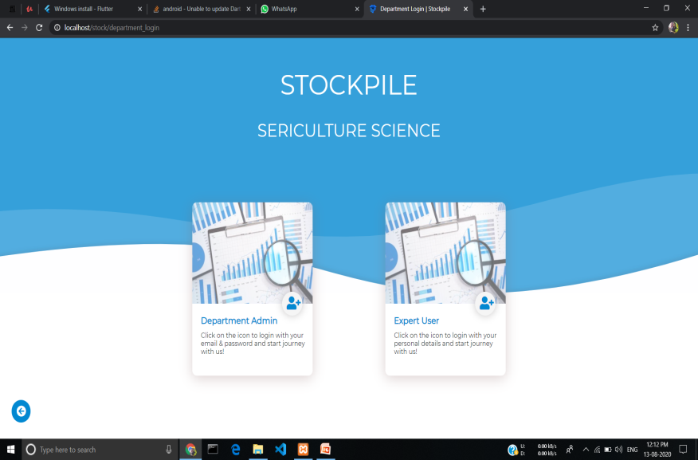
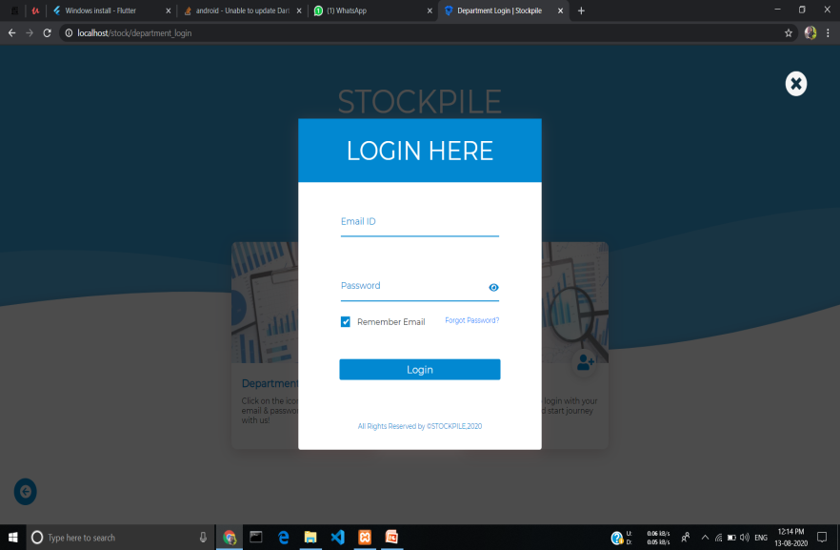


Fig: Snapshot of department admin and expert user login page
Fig: Snapshot of login page
Fig: Snapshot of department admin dashboard tab
Fig: Snapshot of department admin notification tab

Slide 44




Fig: Snapshot of add stock form
Fig: Snapshot of stock records
Fig: Snapshot of issue stock tab
Fig: Snapshot of file details tab

Slide 45
SECURITY MEASURES
Password Hashing: Hashing is the process of converting a given key into another value. It is the transformation of a string of characters into a fixed length value or key that represents the original string. Hashing a password is good because instead of storing the user’s password as plaintext, which is open for anyone to read, it is stored as a hash which is impossible for human to read. Password hashing protects passwords in the event of a security breach. For any reason the database may get compromised and its data may be obtained by someone else. So by hashing we can ensure that the passwords are much safer, even if someone gets their hands on the database, it’s computationally infeasible to calculate the passwords. We are hashing the super-admin, college-admin, department-admin and expert-user’s passwords and storing them in the database securely. As hash functions are one way functions, we cannot get the original text back from the hash. So we can hash any attempted password and compare the result to the saved hash to verify a user’s authentication attempt.
Secure Password Recovery: In any website there should be a Forgot Password service that allows the user to request a password reset so that they can securely recover their passwords. When a user uses the forgot-password service to reset their password, we first ask them to enter their valid email address, if the email is registered, we send them an OTP to their email address

Slide 46
which will get expired in 5 minutes. After entering the OTP system will check and verify if it matched and then they can easily reset their password and get access to their account.
Role Based Authorization: Role based authorization is a method of restricting access based on the roles of individual users. Our system have multiple levels of users i.e. super-admin, college-admin, department-admin and expert-user, each one having access to some specific functions. By implementing this mechanism, the users have access rights only to the information they need to do their jobs and prevent them from accessing information that doesn’t pertain to them. It can regulate who can view or use resources in a system. Security is more easily maintained by limiting unnecessary access to information based on each user’s established role within the system.

Slide 47
CONCLUSION
Now a days, doing works like maintaining stock registers, adding & issuing stock, tracking stock levels, keeping stock related files safely, searching & viewing all the details manually takes so much effort and at the same time it’s very time consuming. In simple words, keeping the records all together in an organized way is very hard with paper. It’s facing a lot of problems in managing the stock records.
So it is required to design a computerized inventory management system to speed up the processes and also make it easy for the authorized users to use the system more effectively.
Hence, the project aims to develop an inventory management system in order to provide solutions to current problems and increase efficiency. This system has been developed with much care and it meets the very basic and necessary needs of the users making it easier to handle all the information. Thus, our system has overcome some of the drawbacks of traditional paper-based system. As the system also provides a facility of simple calculator, the users don’t have to spend a lot of time in calculation & other managing staff. They can now easily monitor their stock related information in just a few minutes without any effort so that the system becomes more useful.

Slide 48
THANK YOU

